Slide 1
Digital Image Competition Results
December, 2020
Farnham u3a Photography Group

Slide 2
After Dark

Slide 3
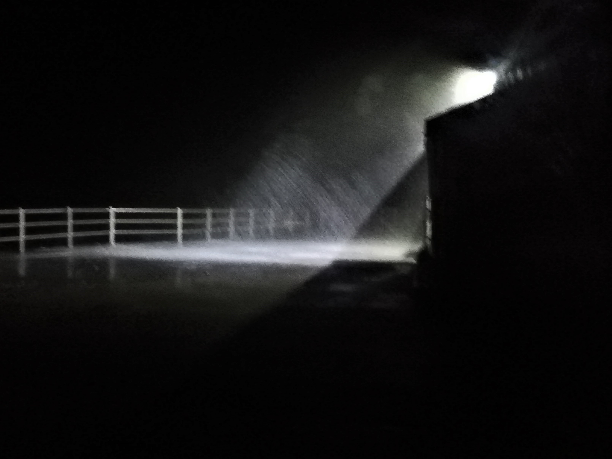
COMMENDED
Sea Spray at Night, Broadstairs
SUE SHAW

Slide 4

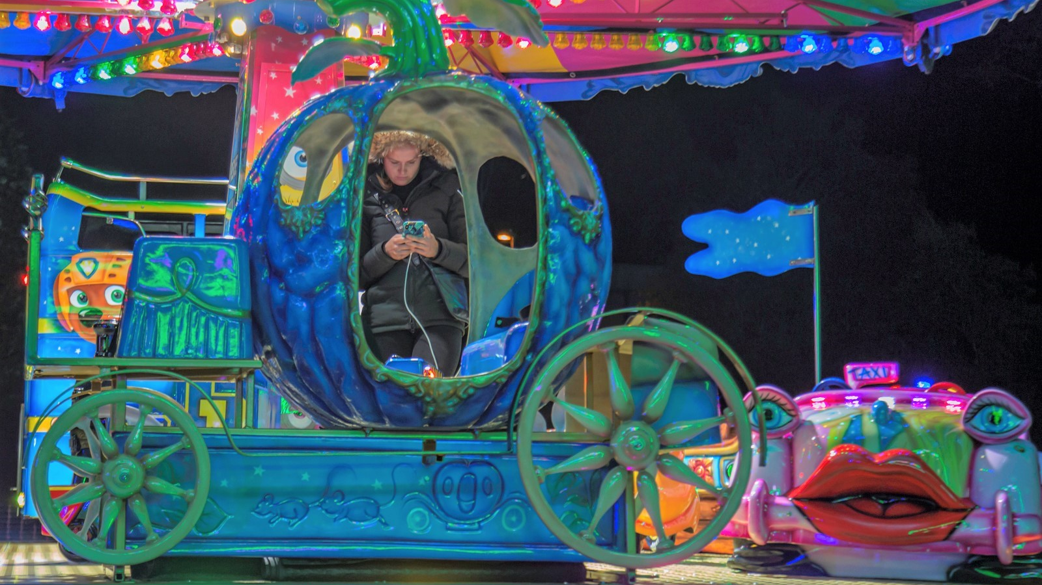
COMMENDED
Uber for Cinderella
ANDREW SORRELL

Slide 5
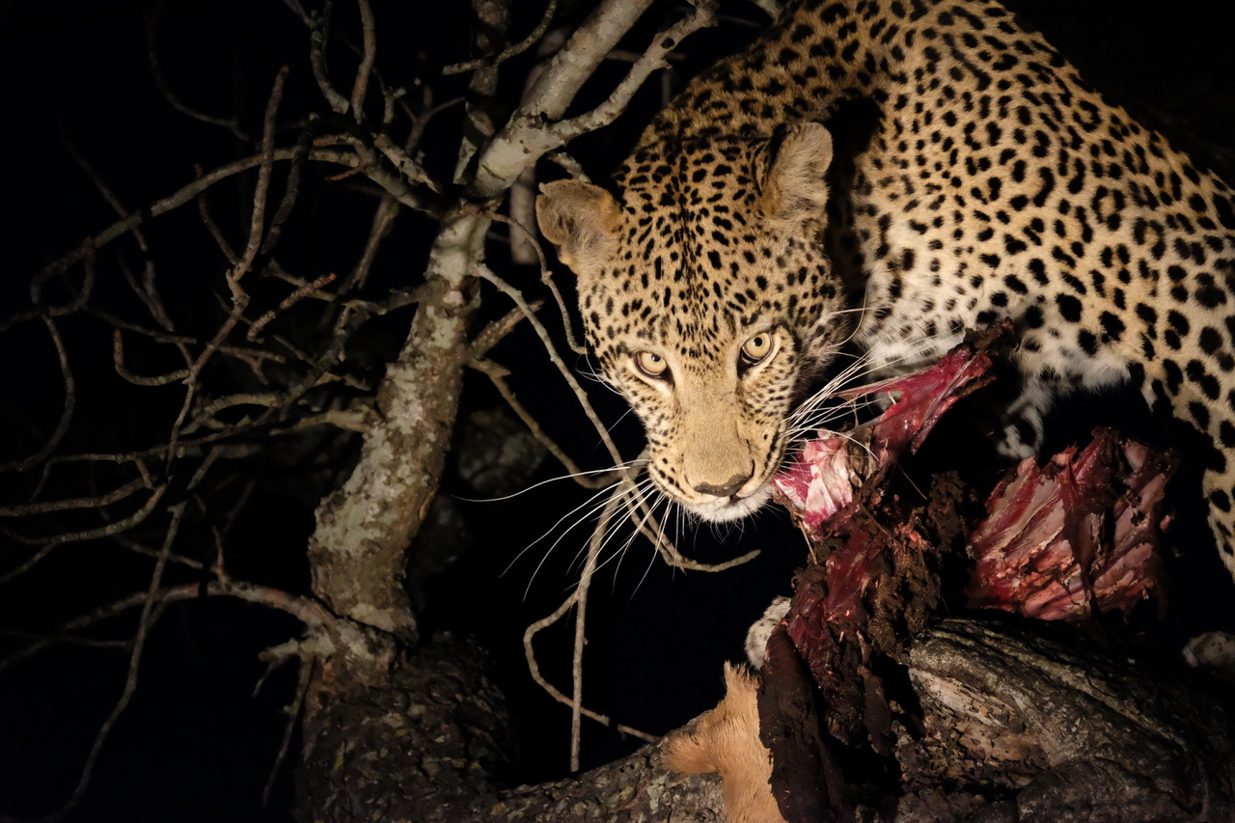
COMMENDED
Night-time Snack
PAULINE TAYLOR

Slide 6
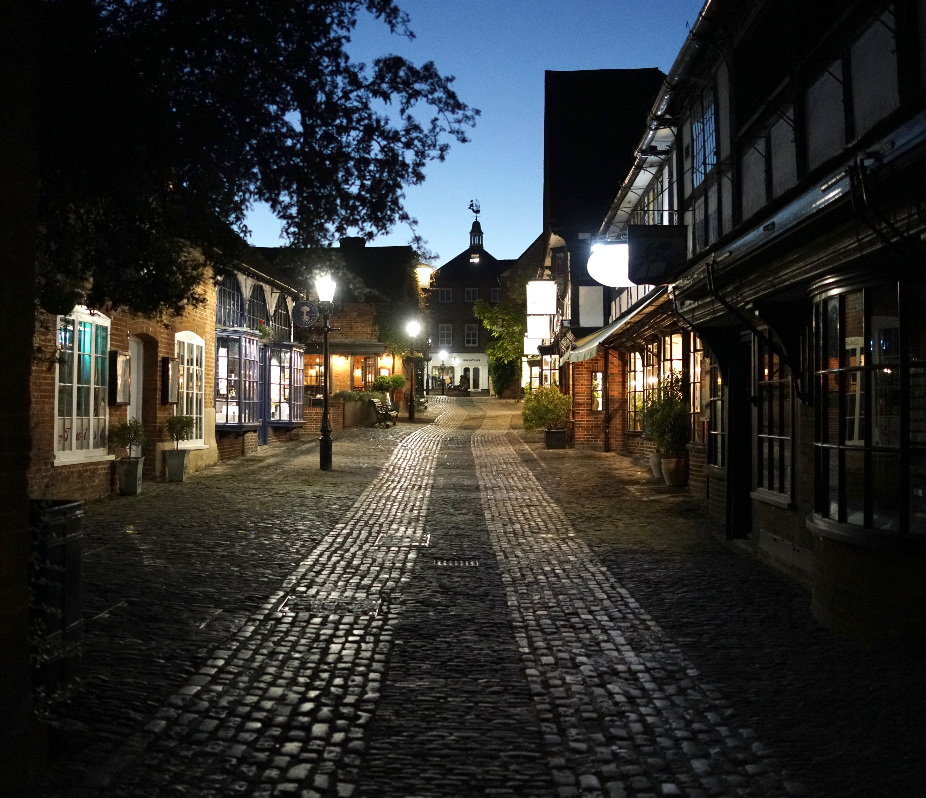
THIRD PLACE
Lion and Lamb
JOHN ATKINSON

Slide 7
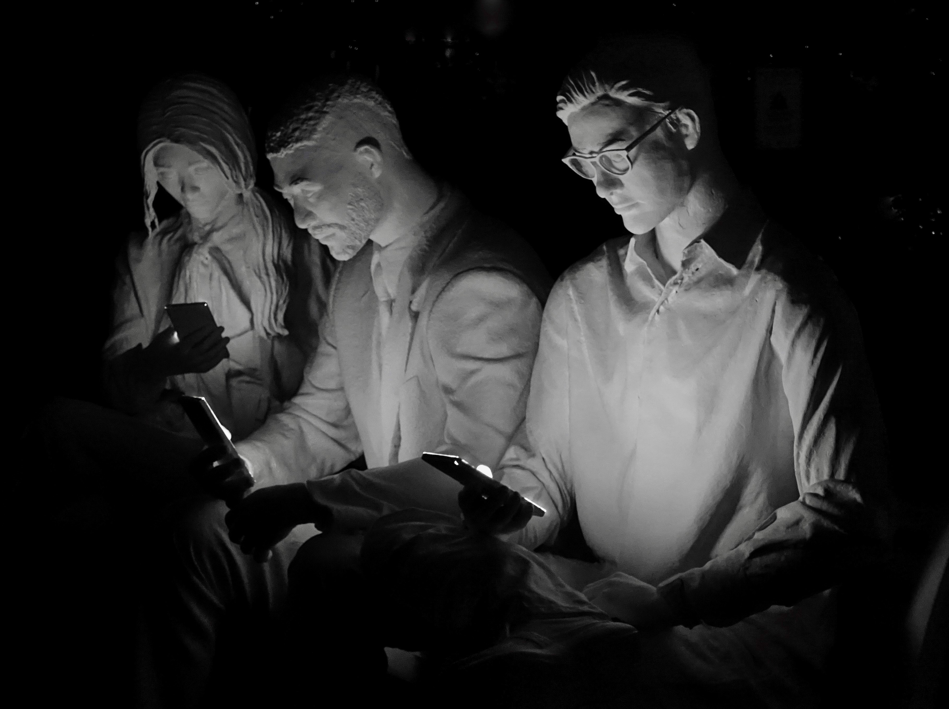
SECOND PLACE
Millennial Addiction
SUE DAY

Slide 8
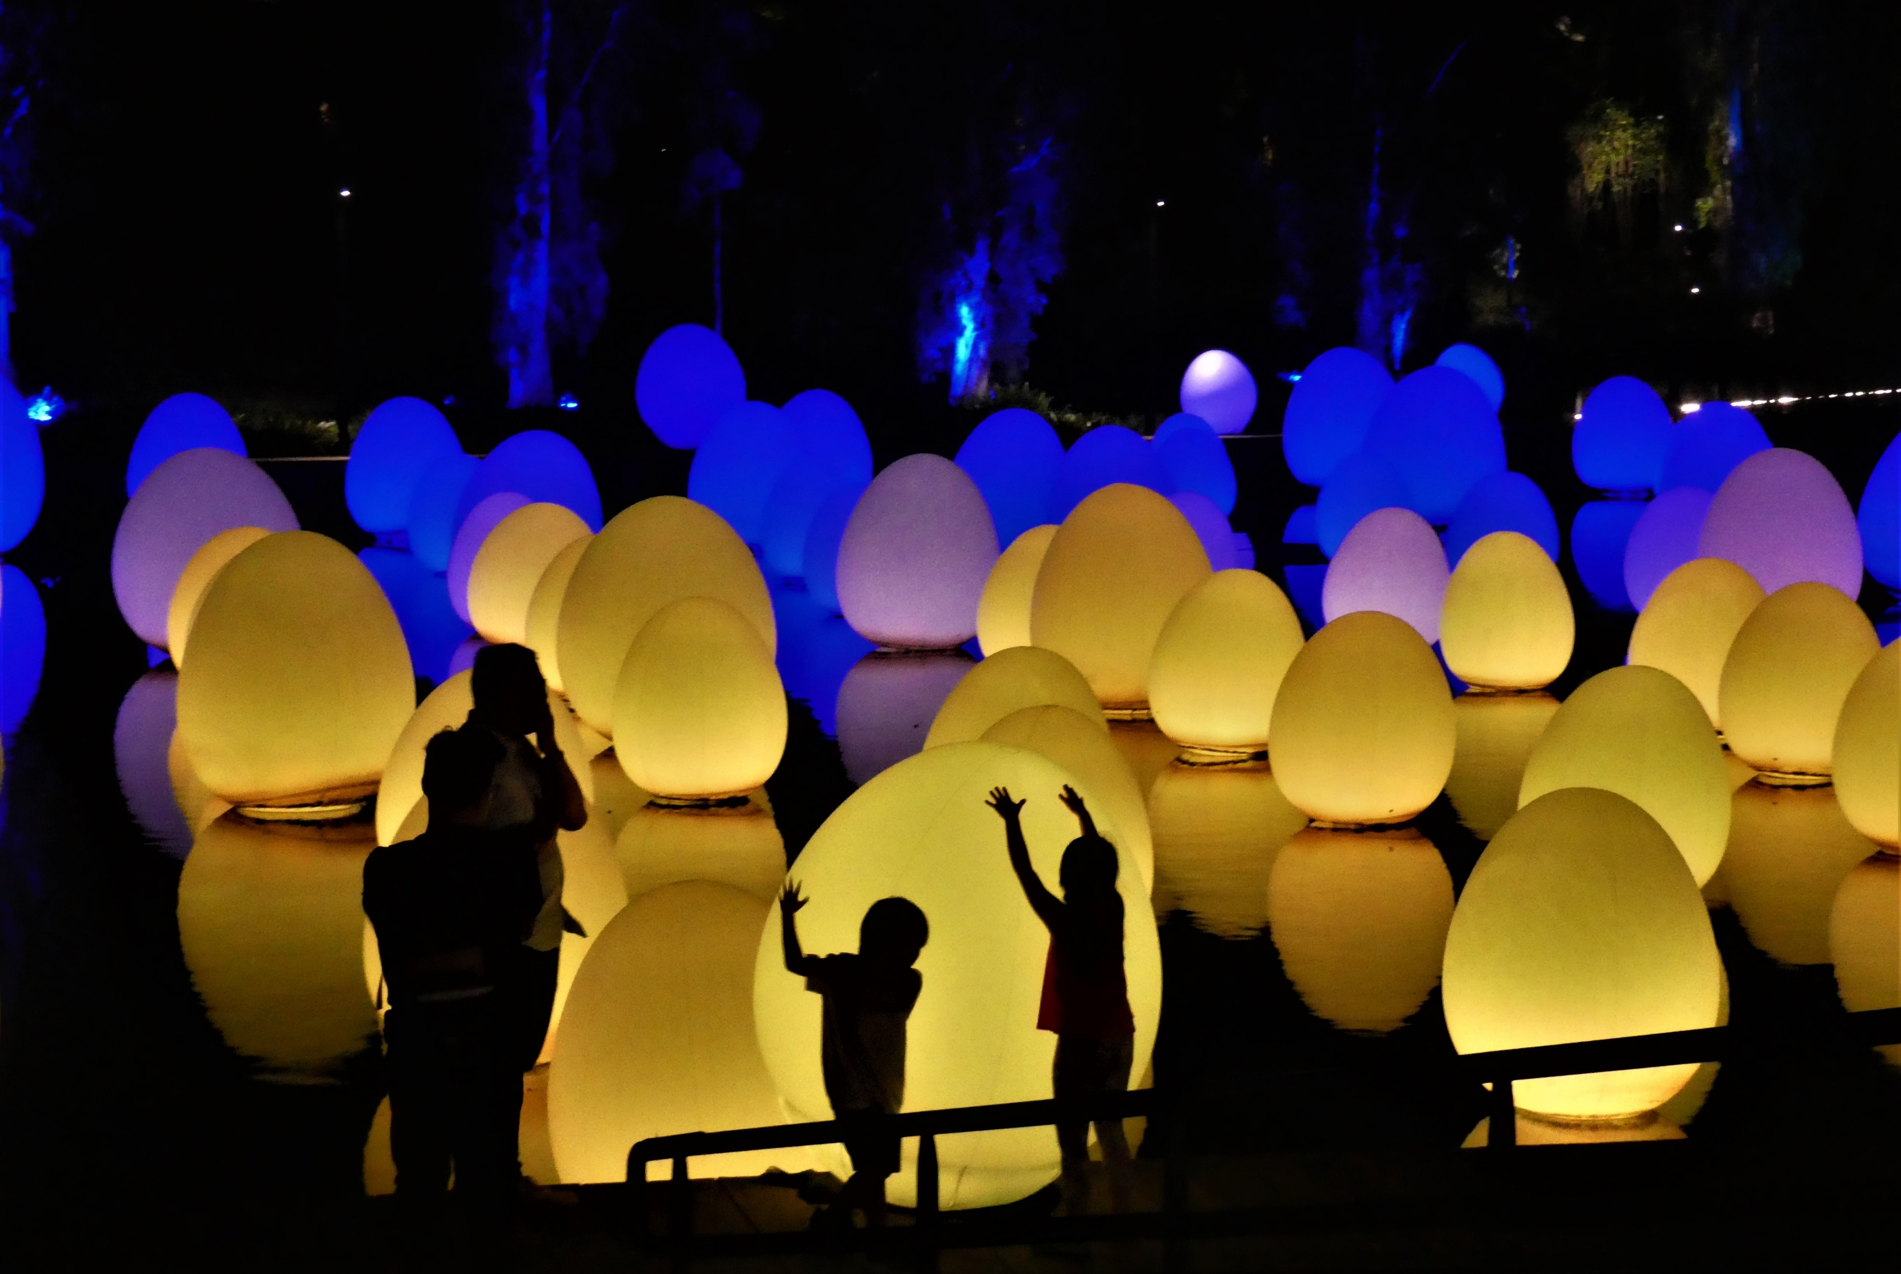
FIRST PLACE
Shadows
DAVID ALLEN

Slide 9
Figures in a Landscape

Slide 10
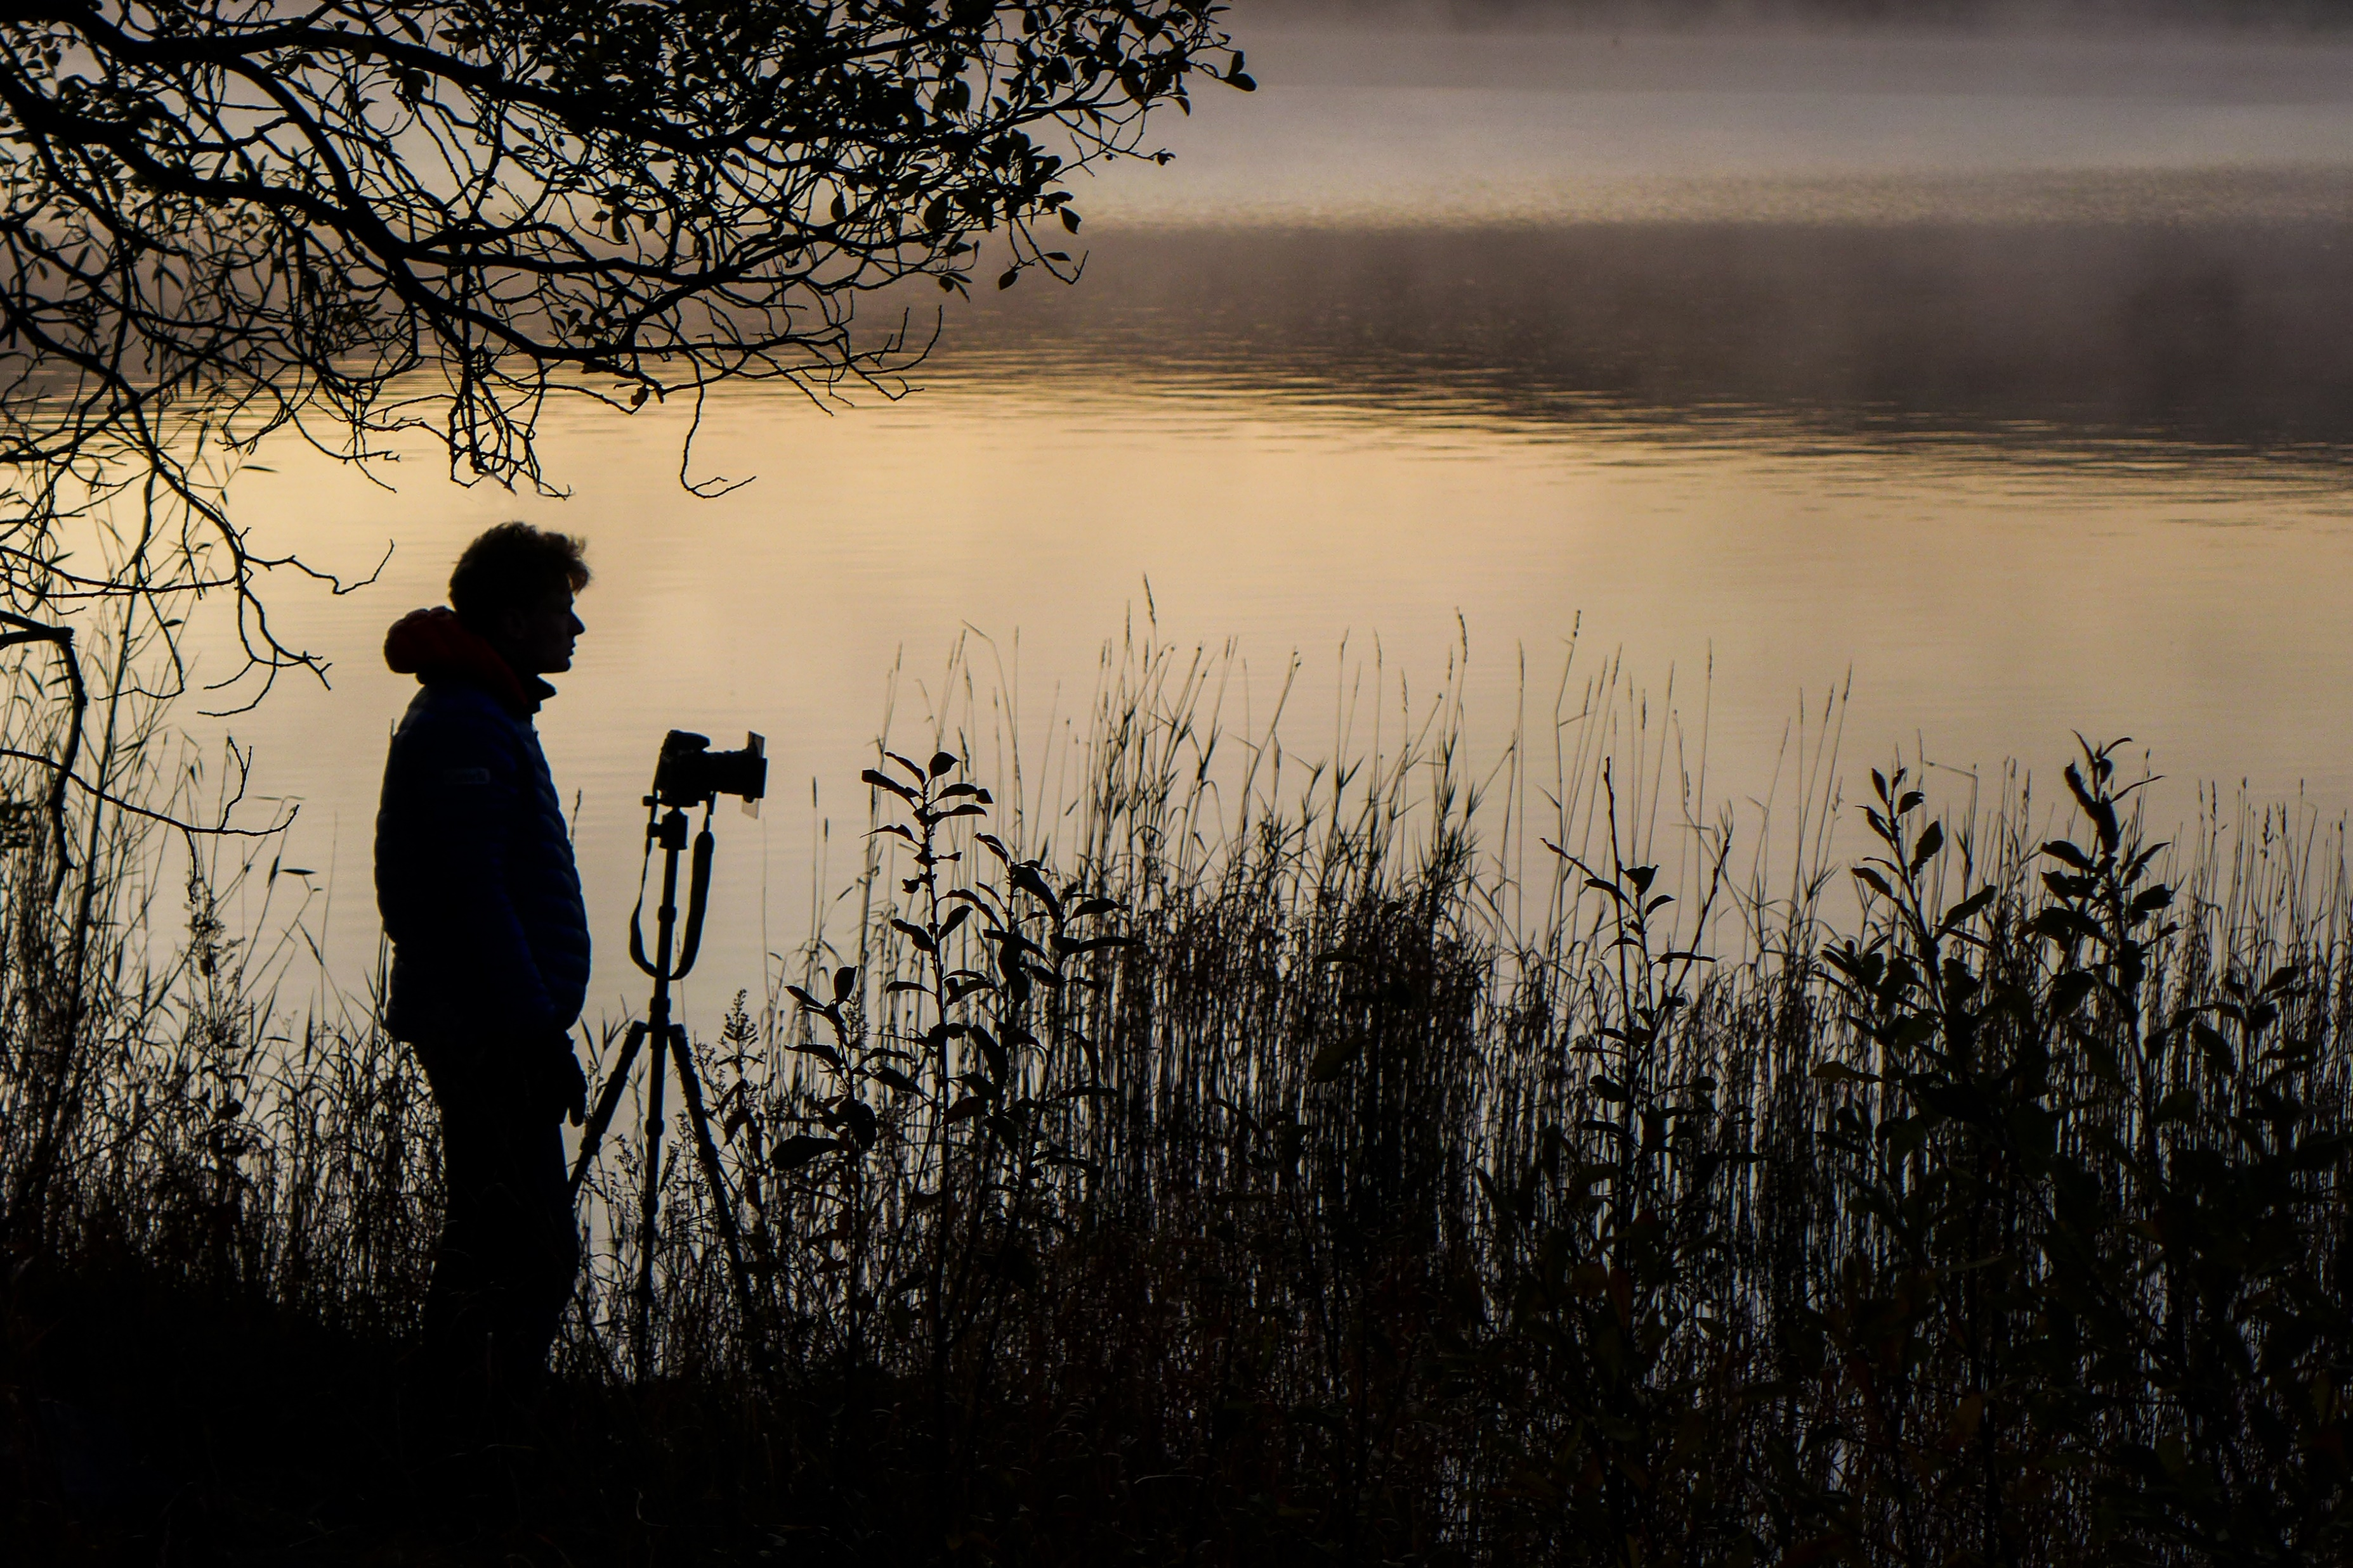
COMMENDED
Waiting for First Light
TONY WATSON

Slide 11
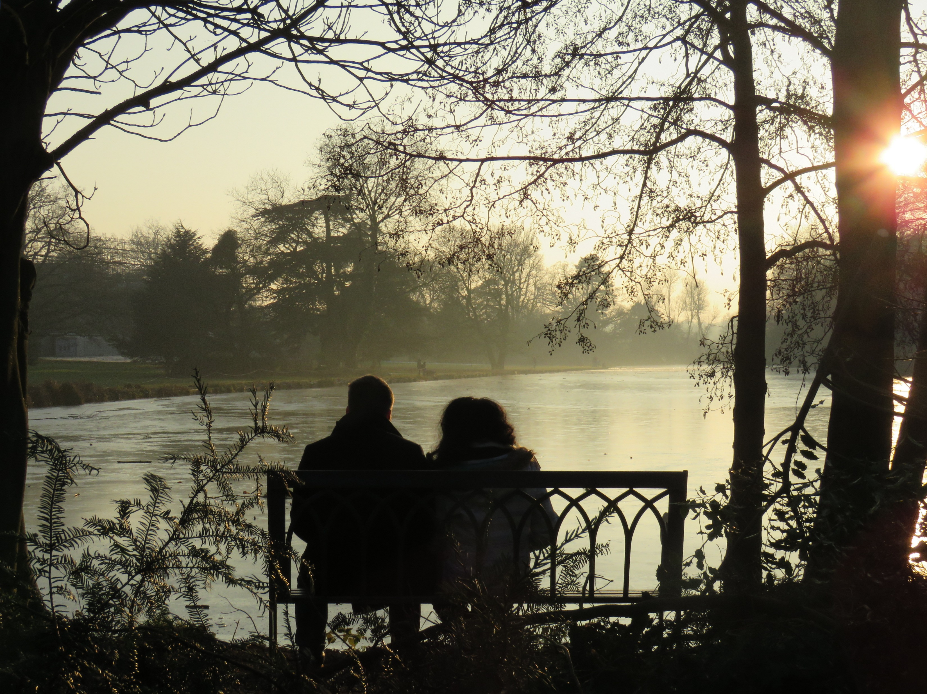
COMMENDED
Winter Romance
GEORGINA CRAWLEY

Slide 12
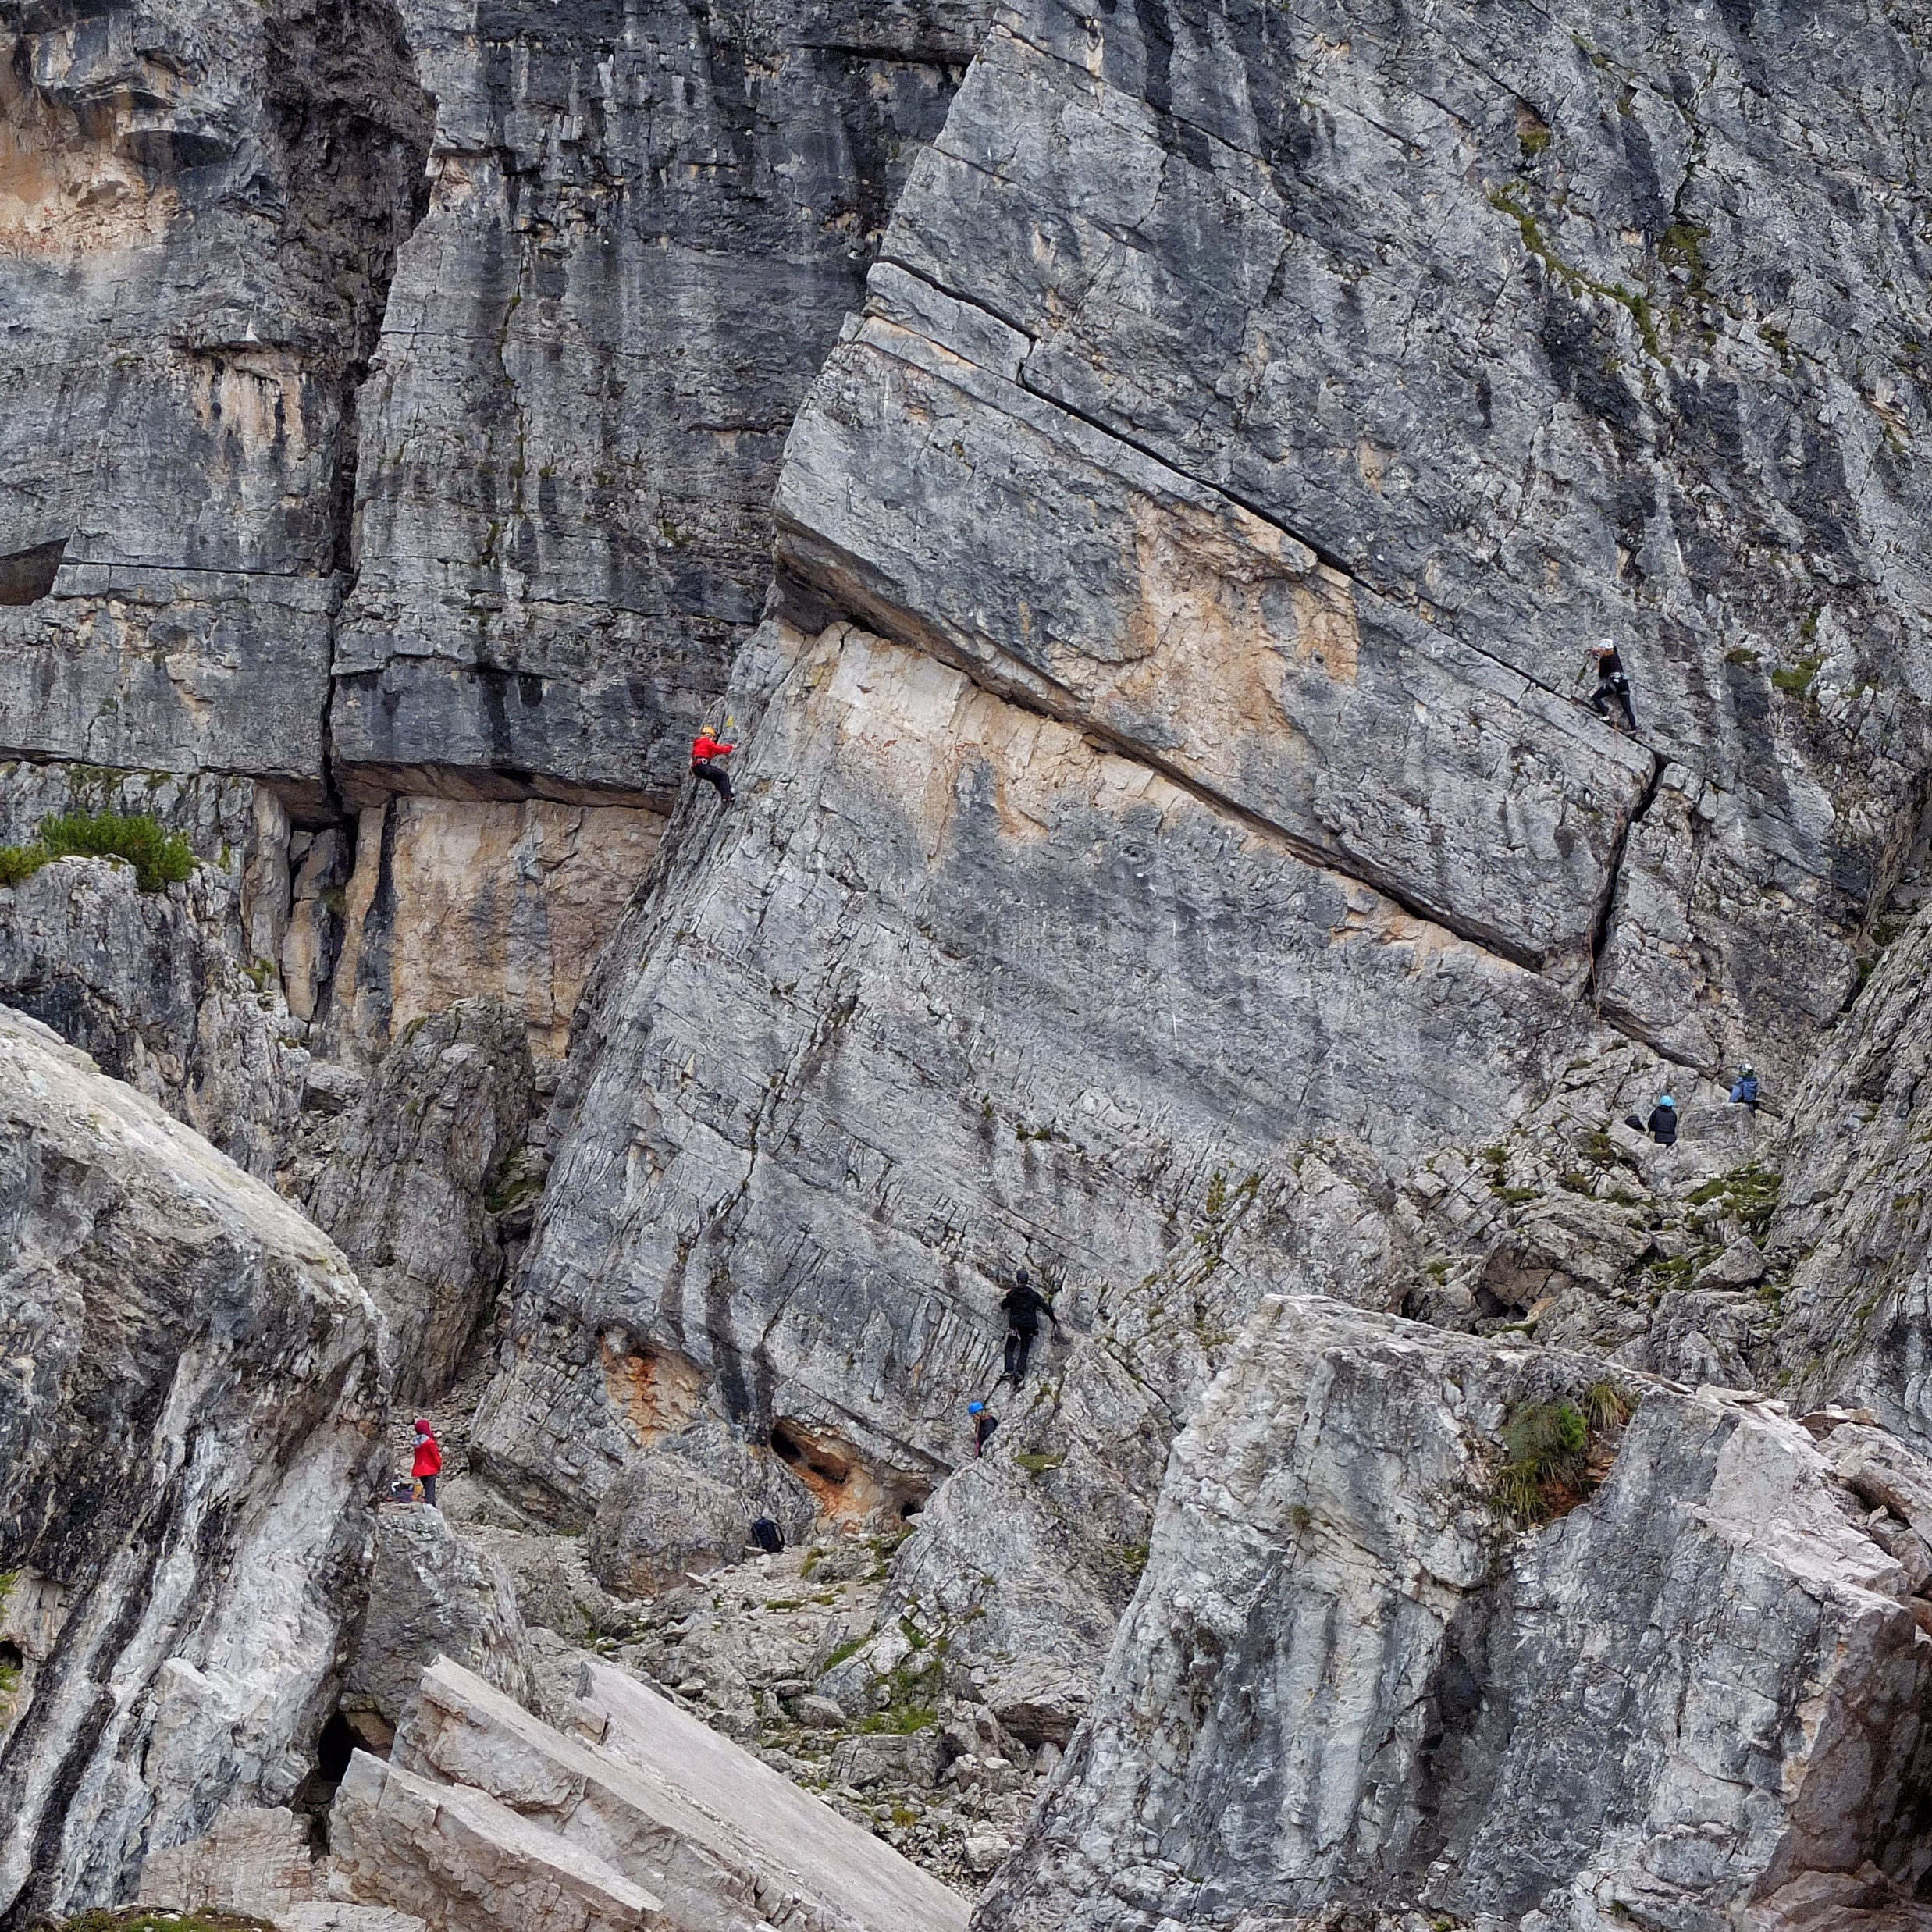
COMMENDED
Climbers Everywhere
DAVID GEORGHIOU

Slide 13
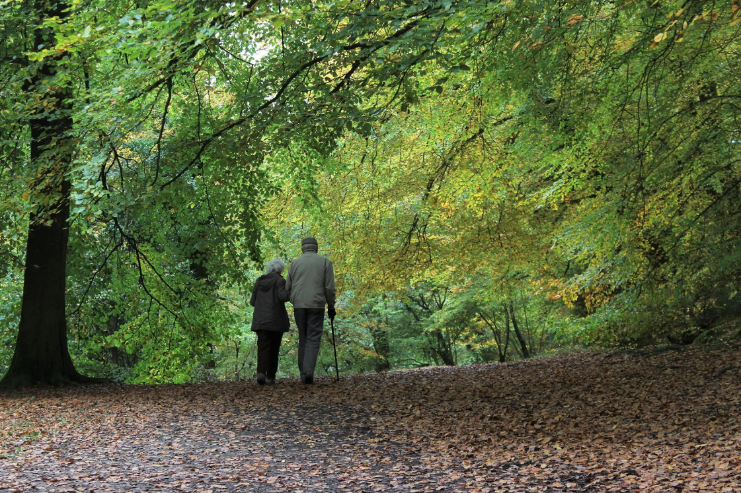
THIRD PLACE
Life’s Twilighter Stroll
SUE LAST

Slide 14
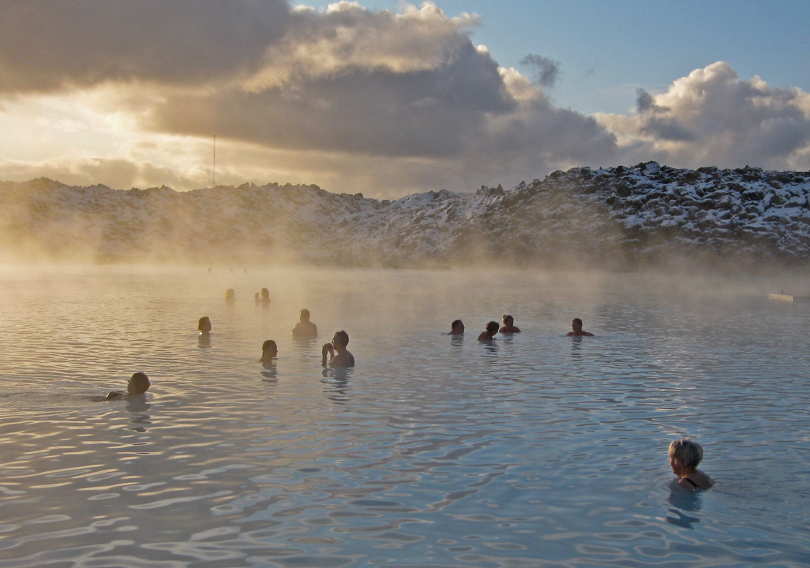
SECOND PLACE
Warmth in a Cold Place
TONY RADNOR

Slide 15
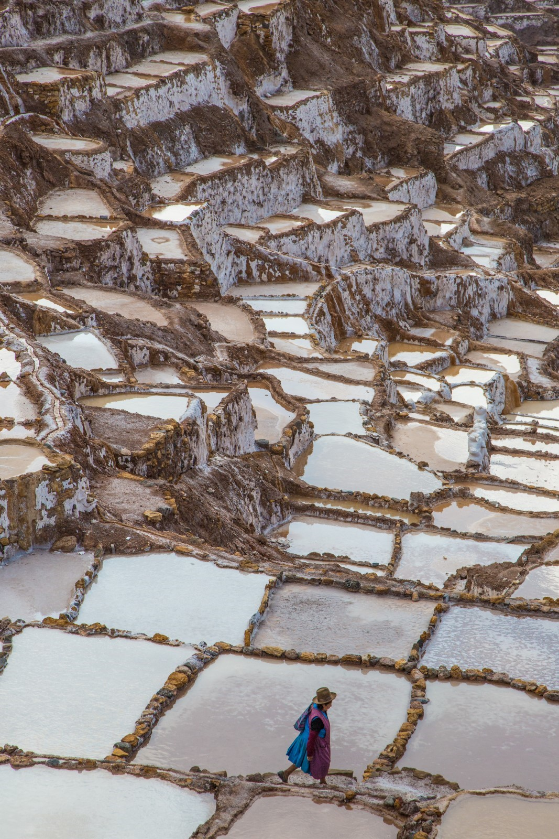
FIRST PLACE
Salt Pans, Peru
ANDREW SORRELL

Slide 16
Skylines

Slide 17
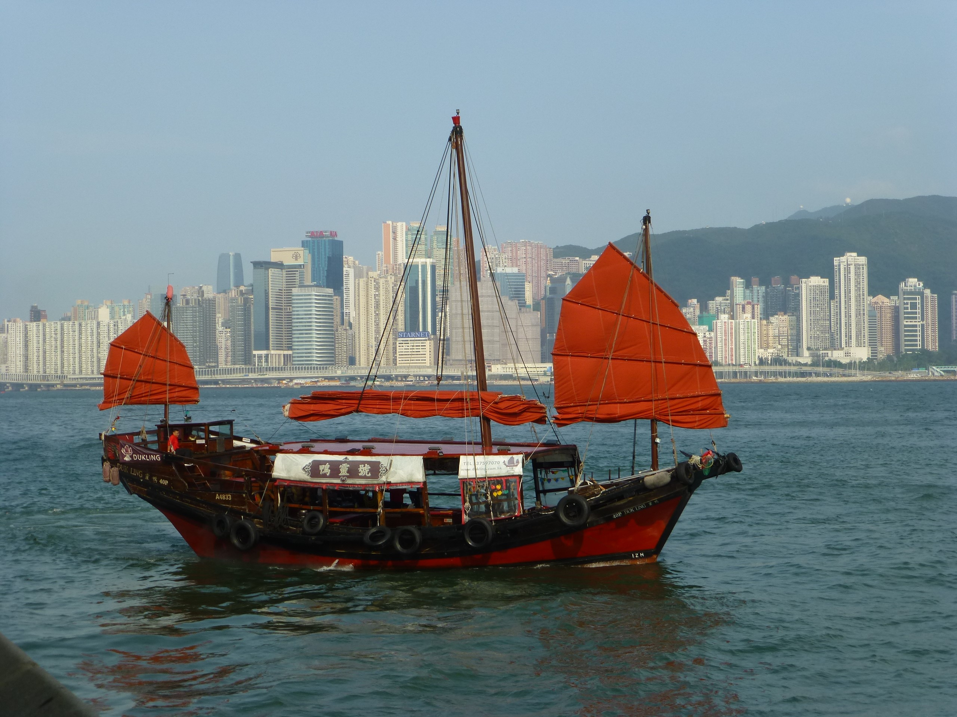
COMMENDED
Slow Boat to China
ROGER COLE

Slide 18
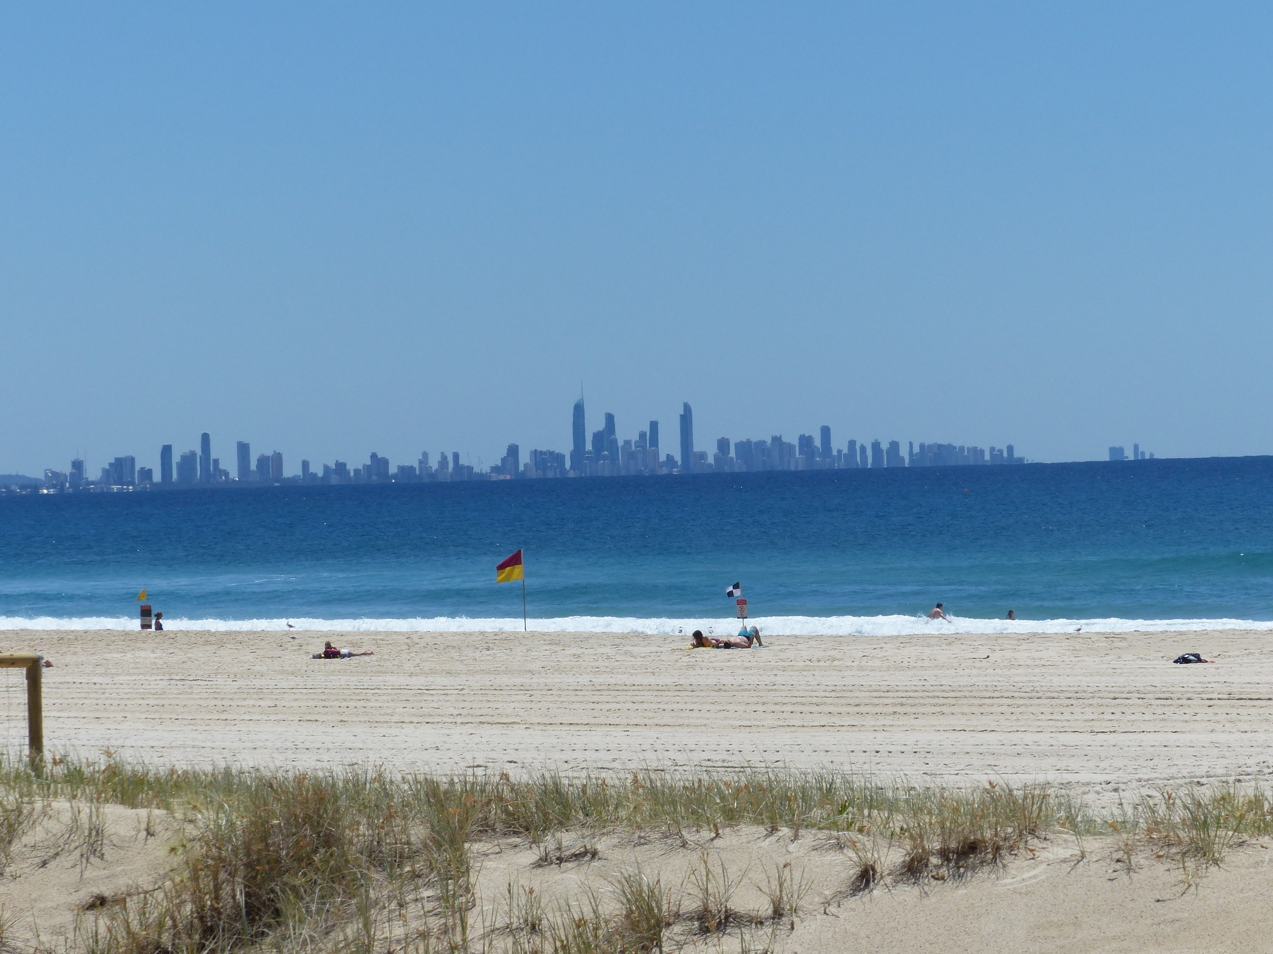
COMMENDED
Gold Coast Across the Bay
NARGARET JARVIS

Slide 19
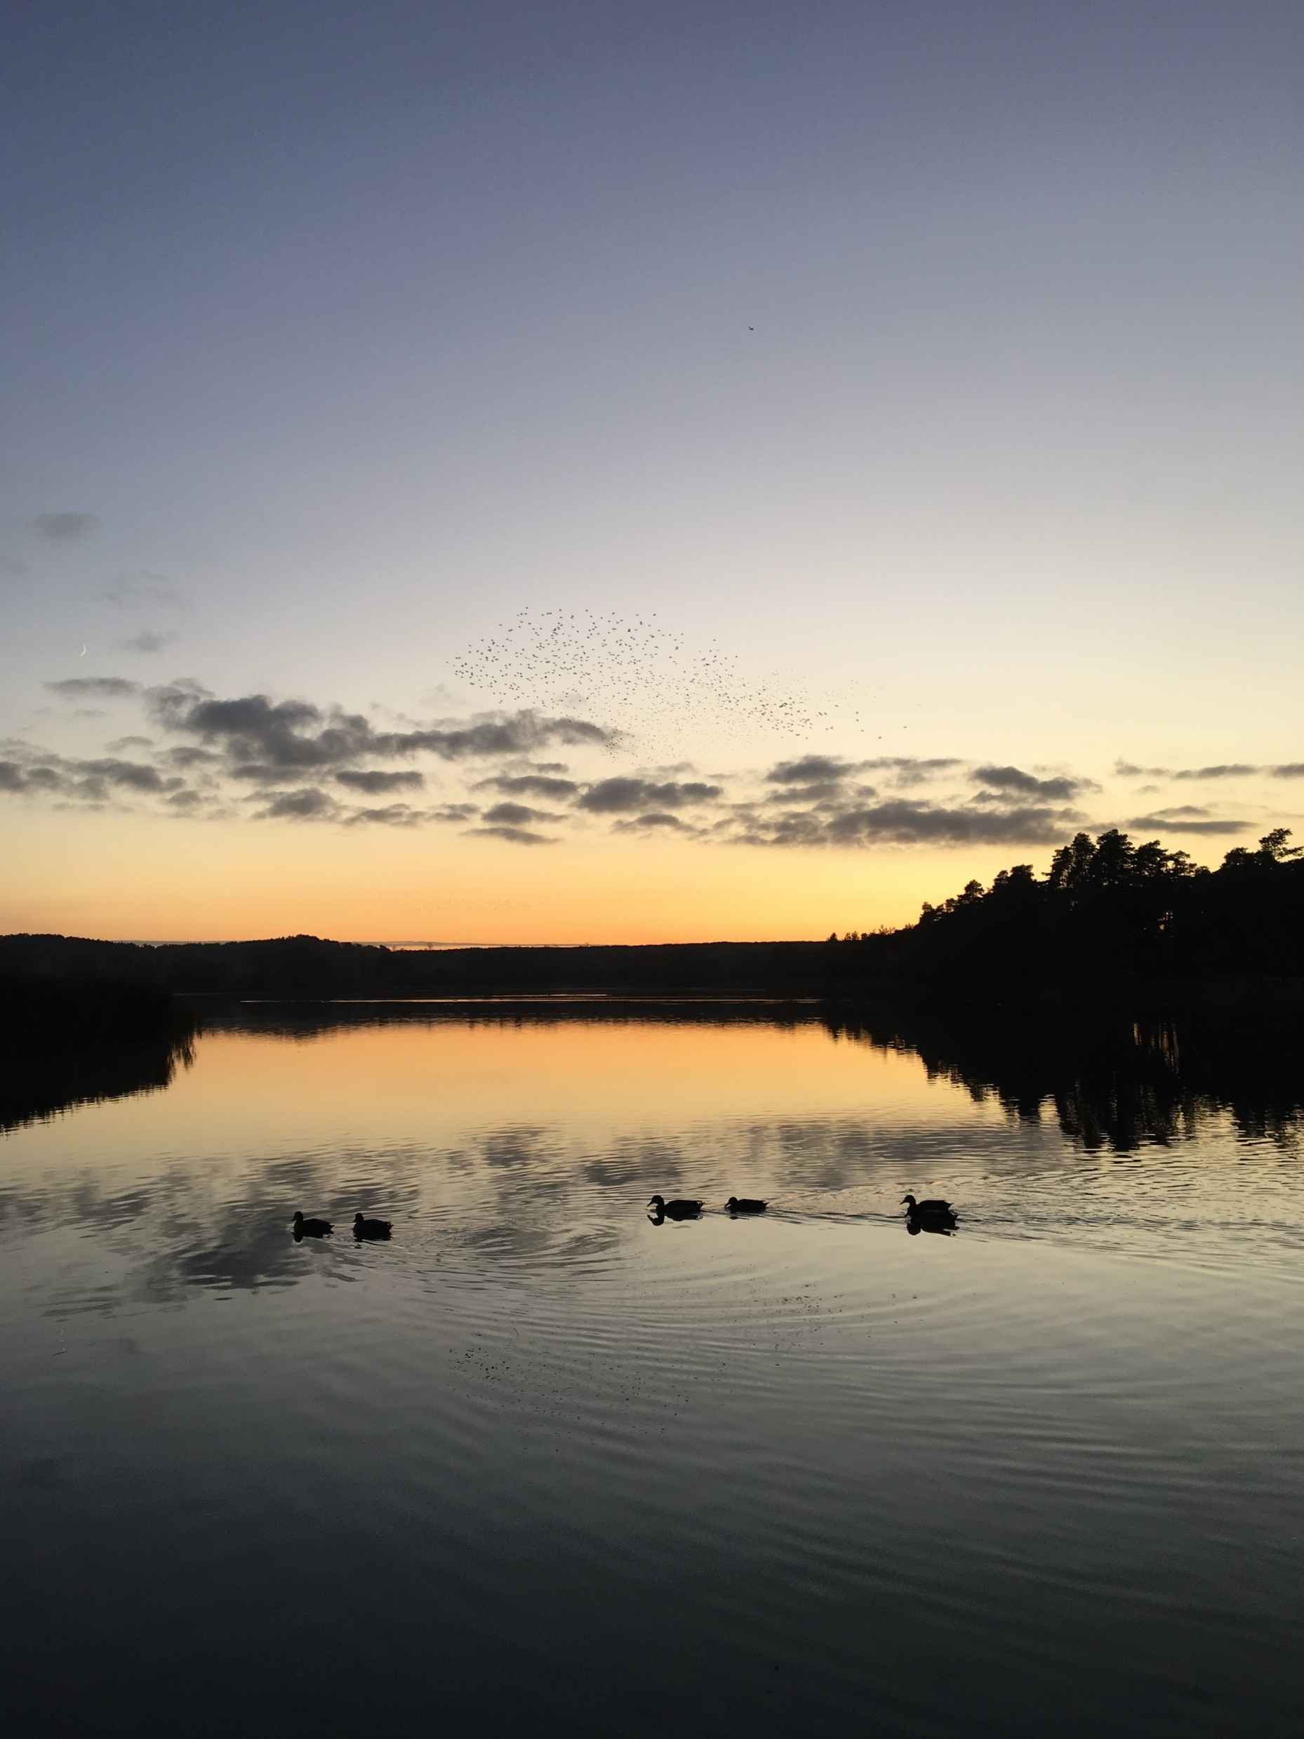
COMMENDED
A Hint of Murmuration
TRICIA OSBORNE

Slide 20
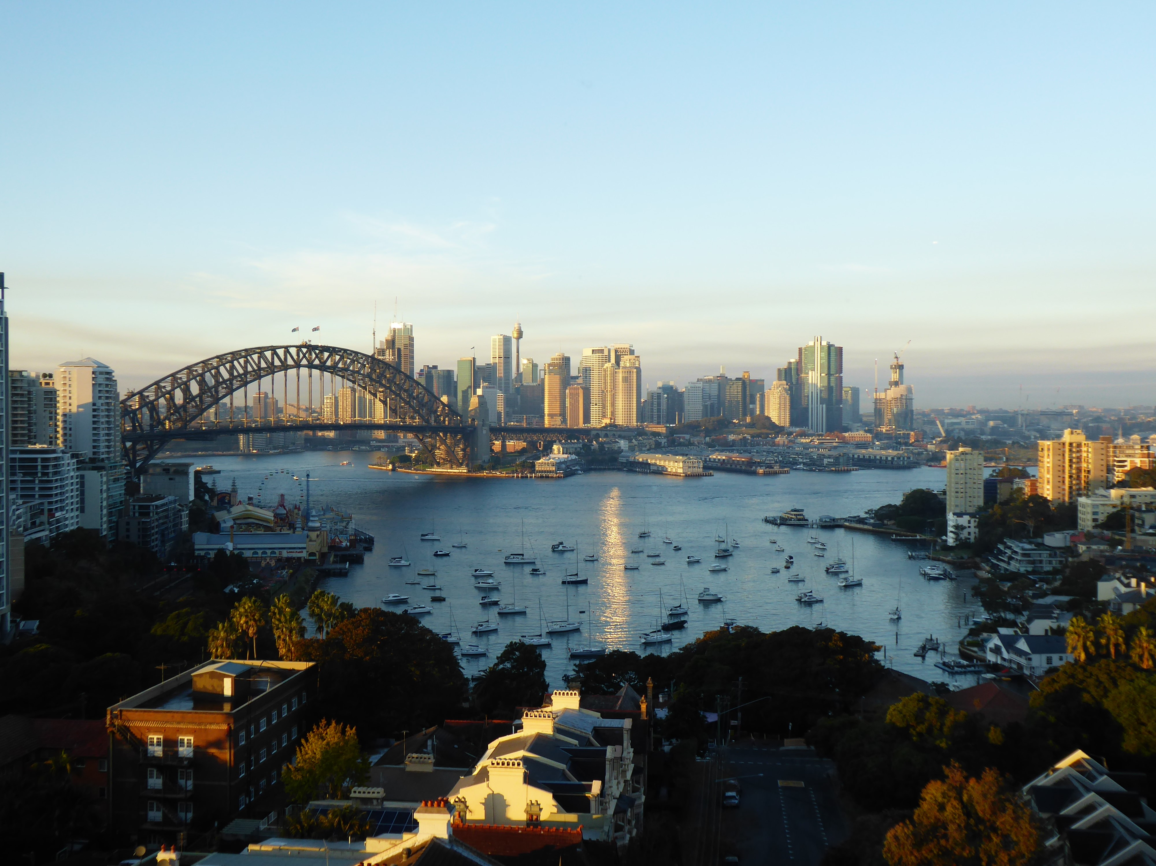
THIRD PLACE
A Room With a View
ANN COLE

Slide 21
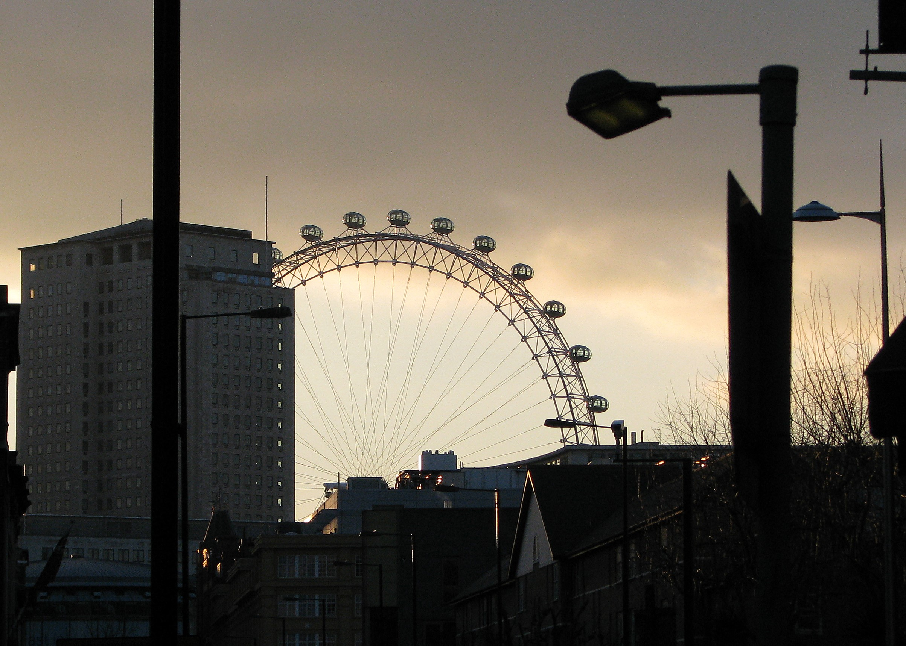
SECOND PLACE
London Eye at Dusk
DAVID MATTHEWS

Slide 22
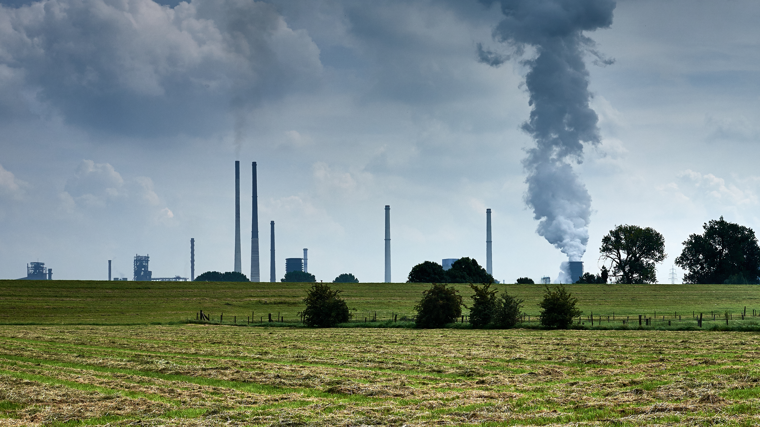
FIRST PLACE
Along the Rhine
DAVID GEORGHIOU

Slide 23
Wildlife

Slide 24
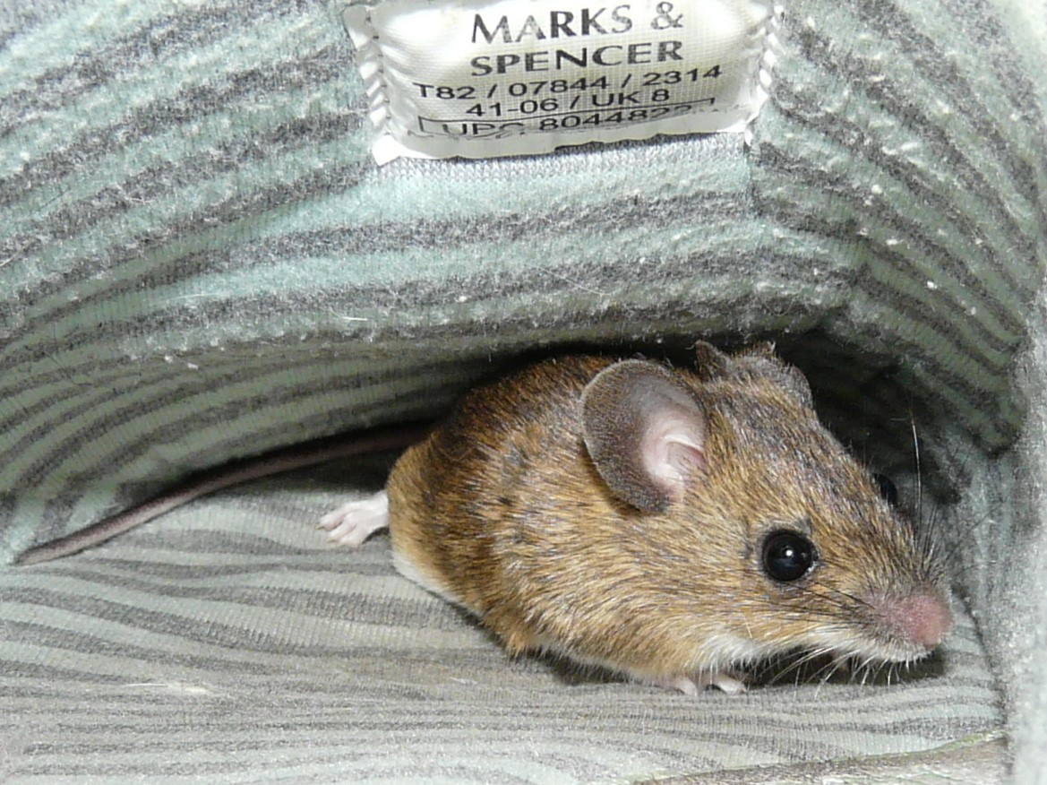
COMMENDED
Not Just Any Mouse…
SHEELAGH MAYES

Slide 25
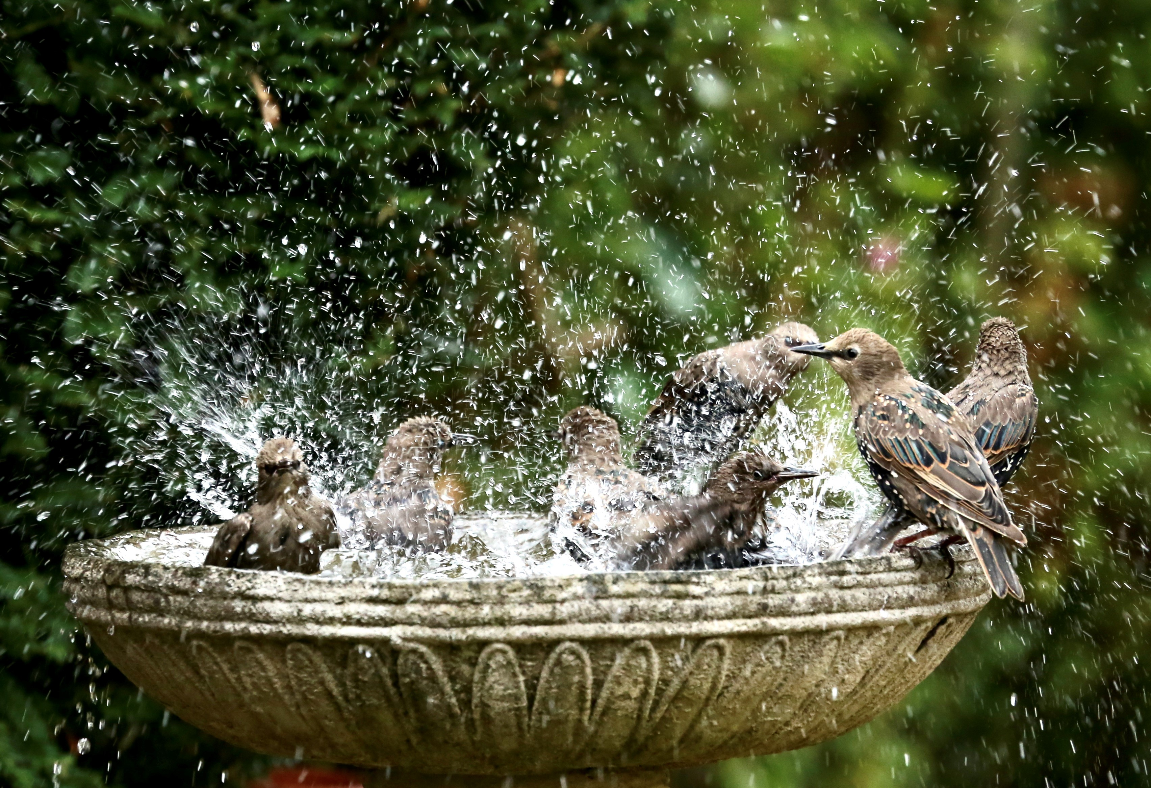
COMMENDED
Where’s the Soap?
JOHN ATKINSON

Slide 26
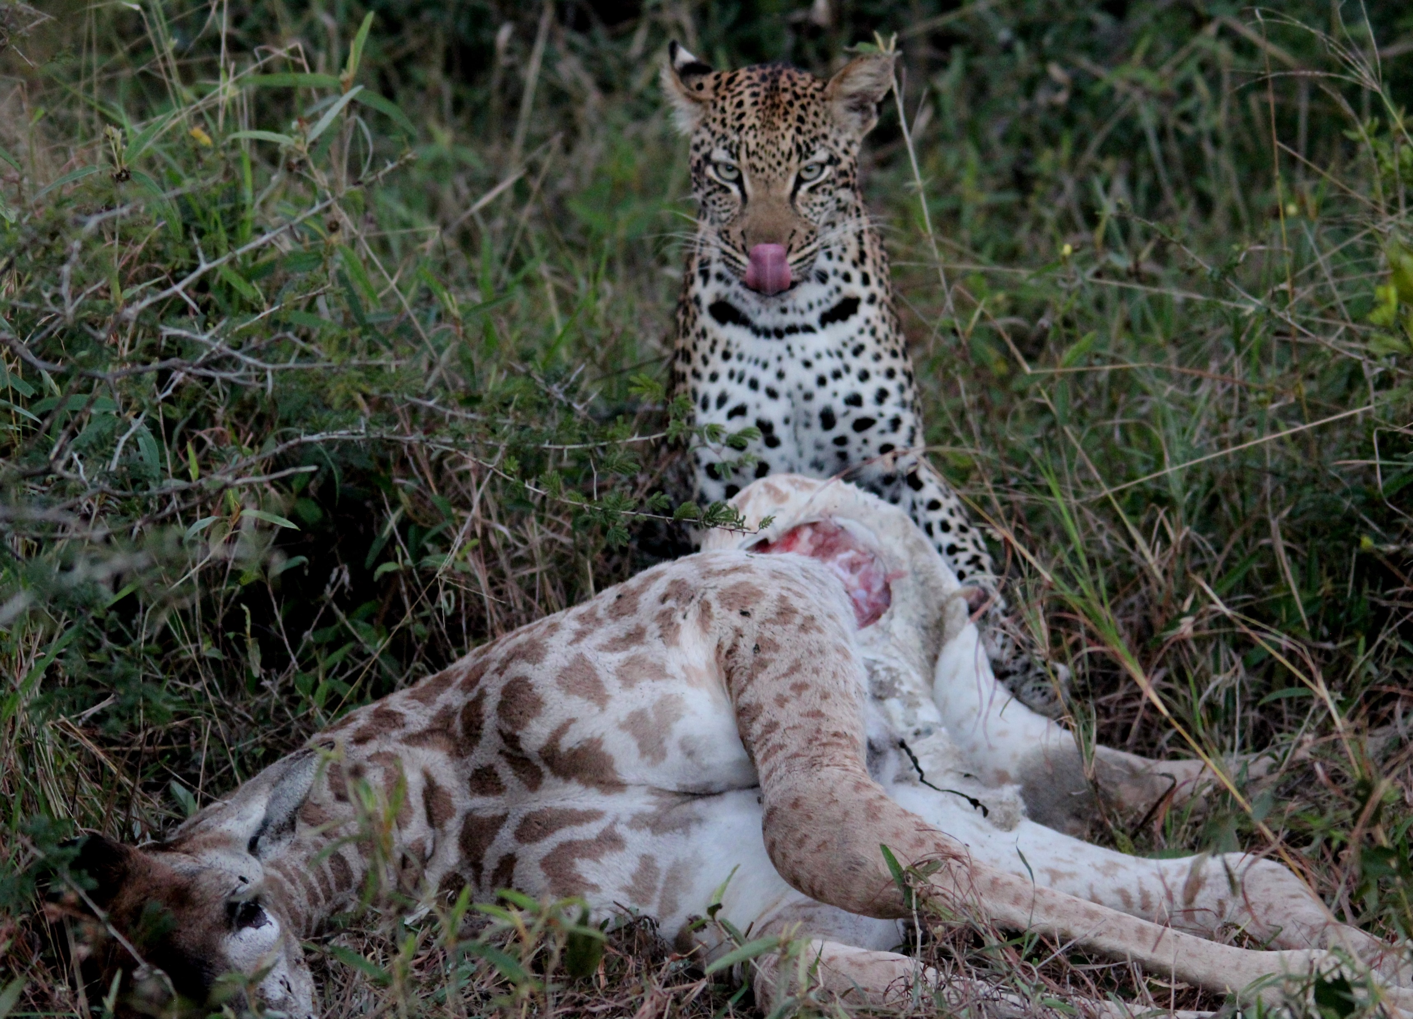
COMMENDED
A Leopard’s Lunch
DAVID ALLEN

Slide 27
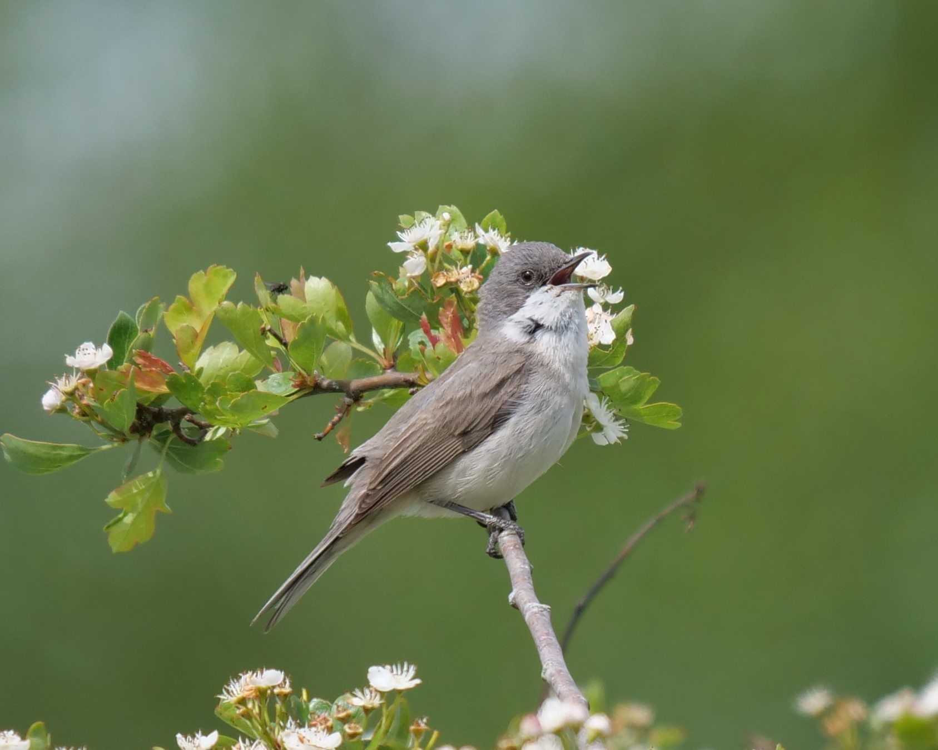
THIRD PLACE
Lesser Whitethroat
ROGER TWITCHIN

Slide 28
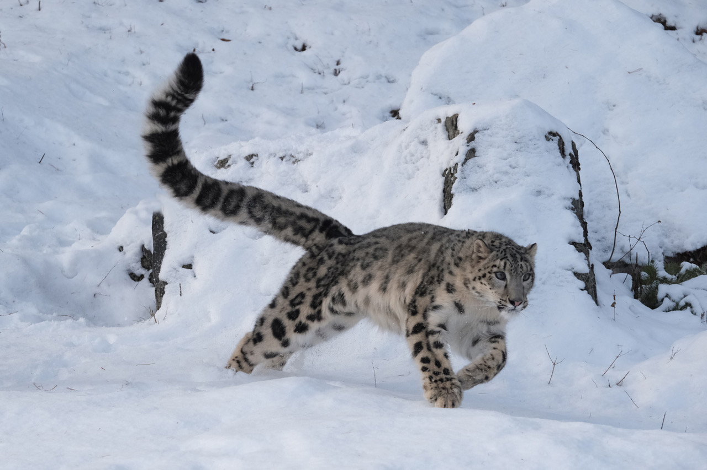
SECOND PLACE
Running Down Mountain
PAULINE TAYLOR

Slide 29
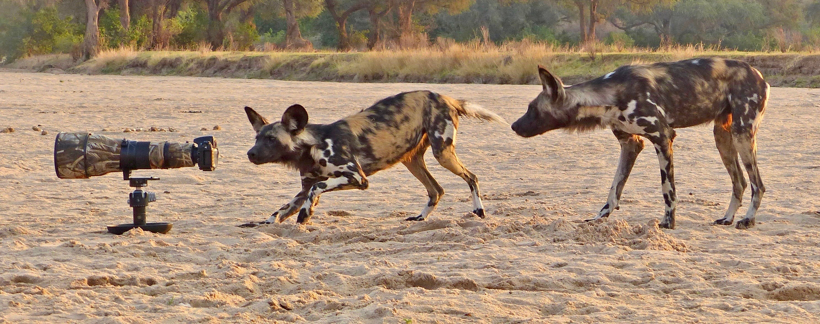
FIRST PLACE
Are You Sure It’s OK?
SHEELAGH MAYES

Slide 30
Open

Slide 31
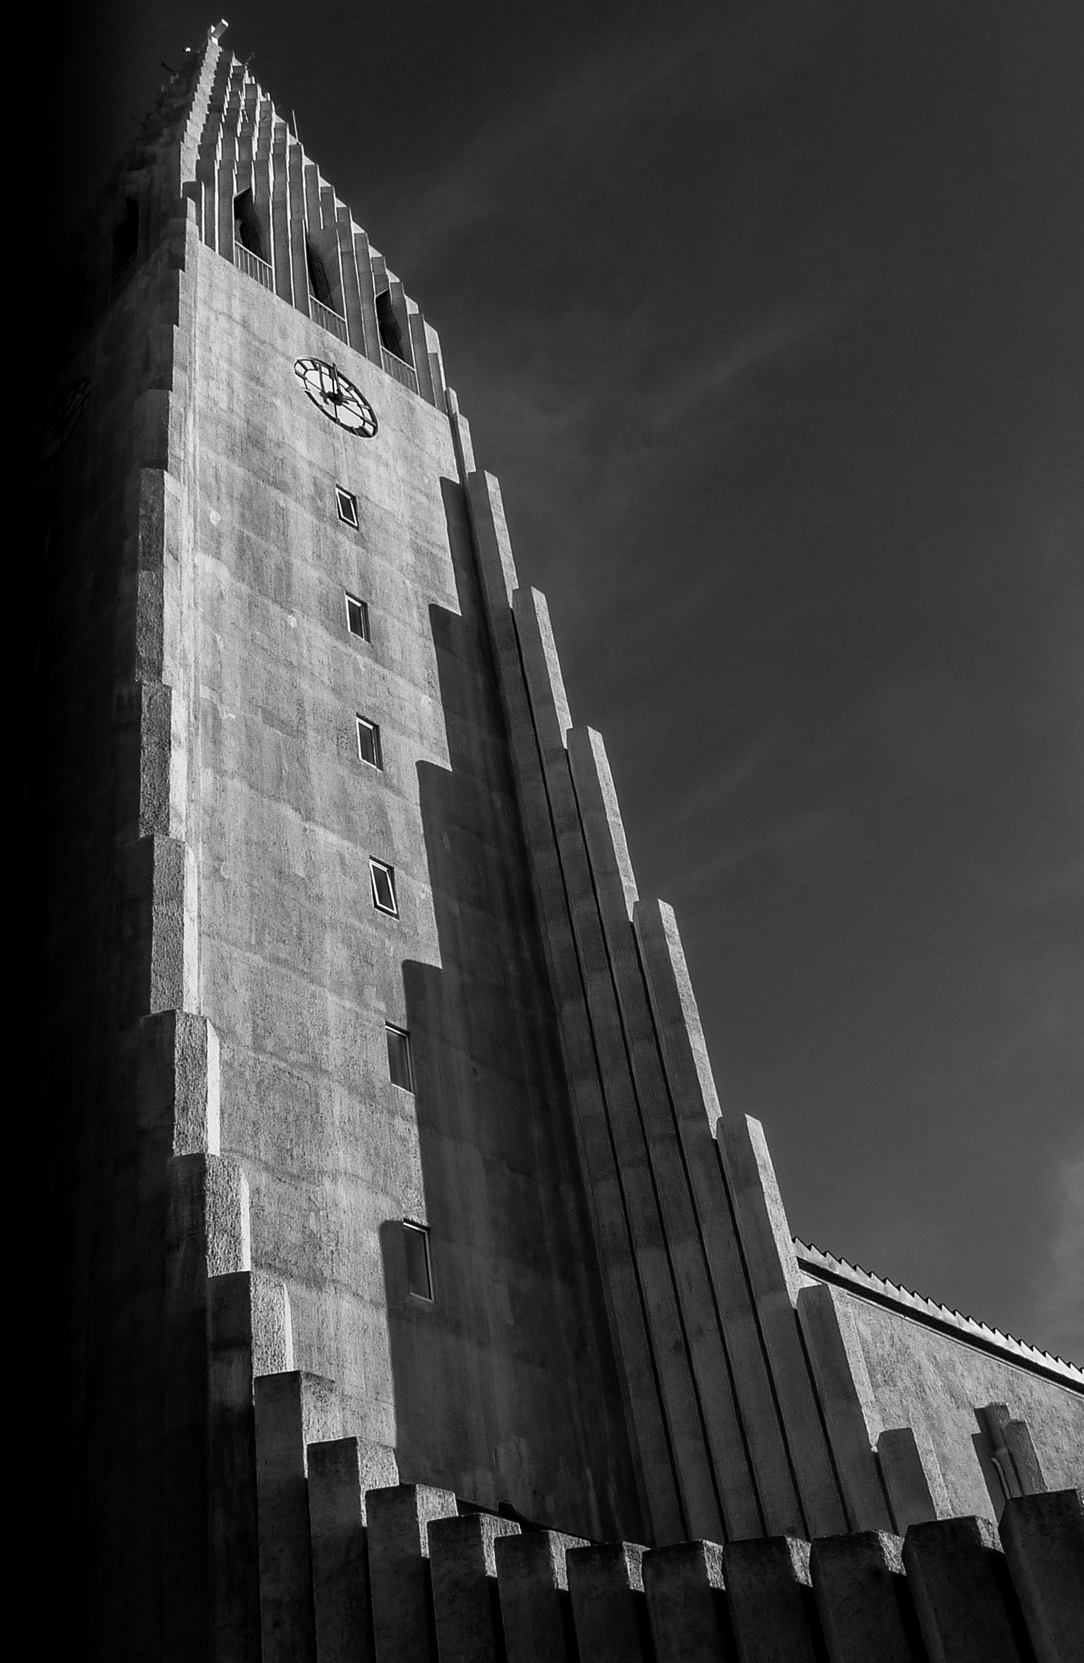
COMMENDED
Hallgrimskirkja, Reykjavic
DOUG GORDON

Slide 32
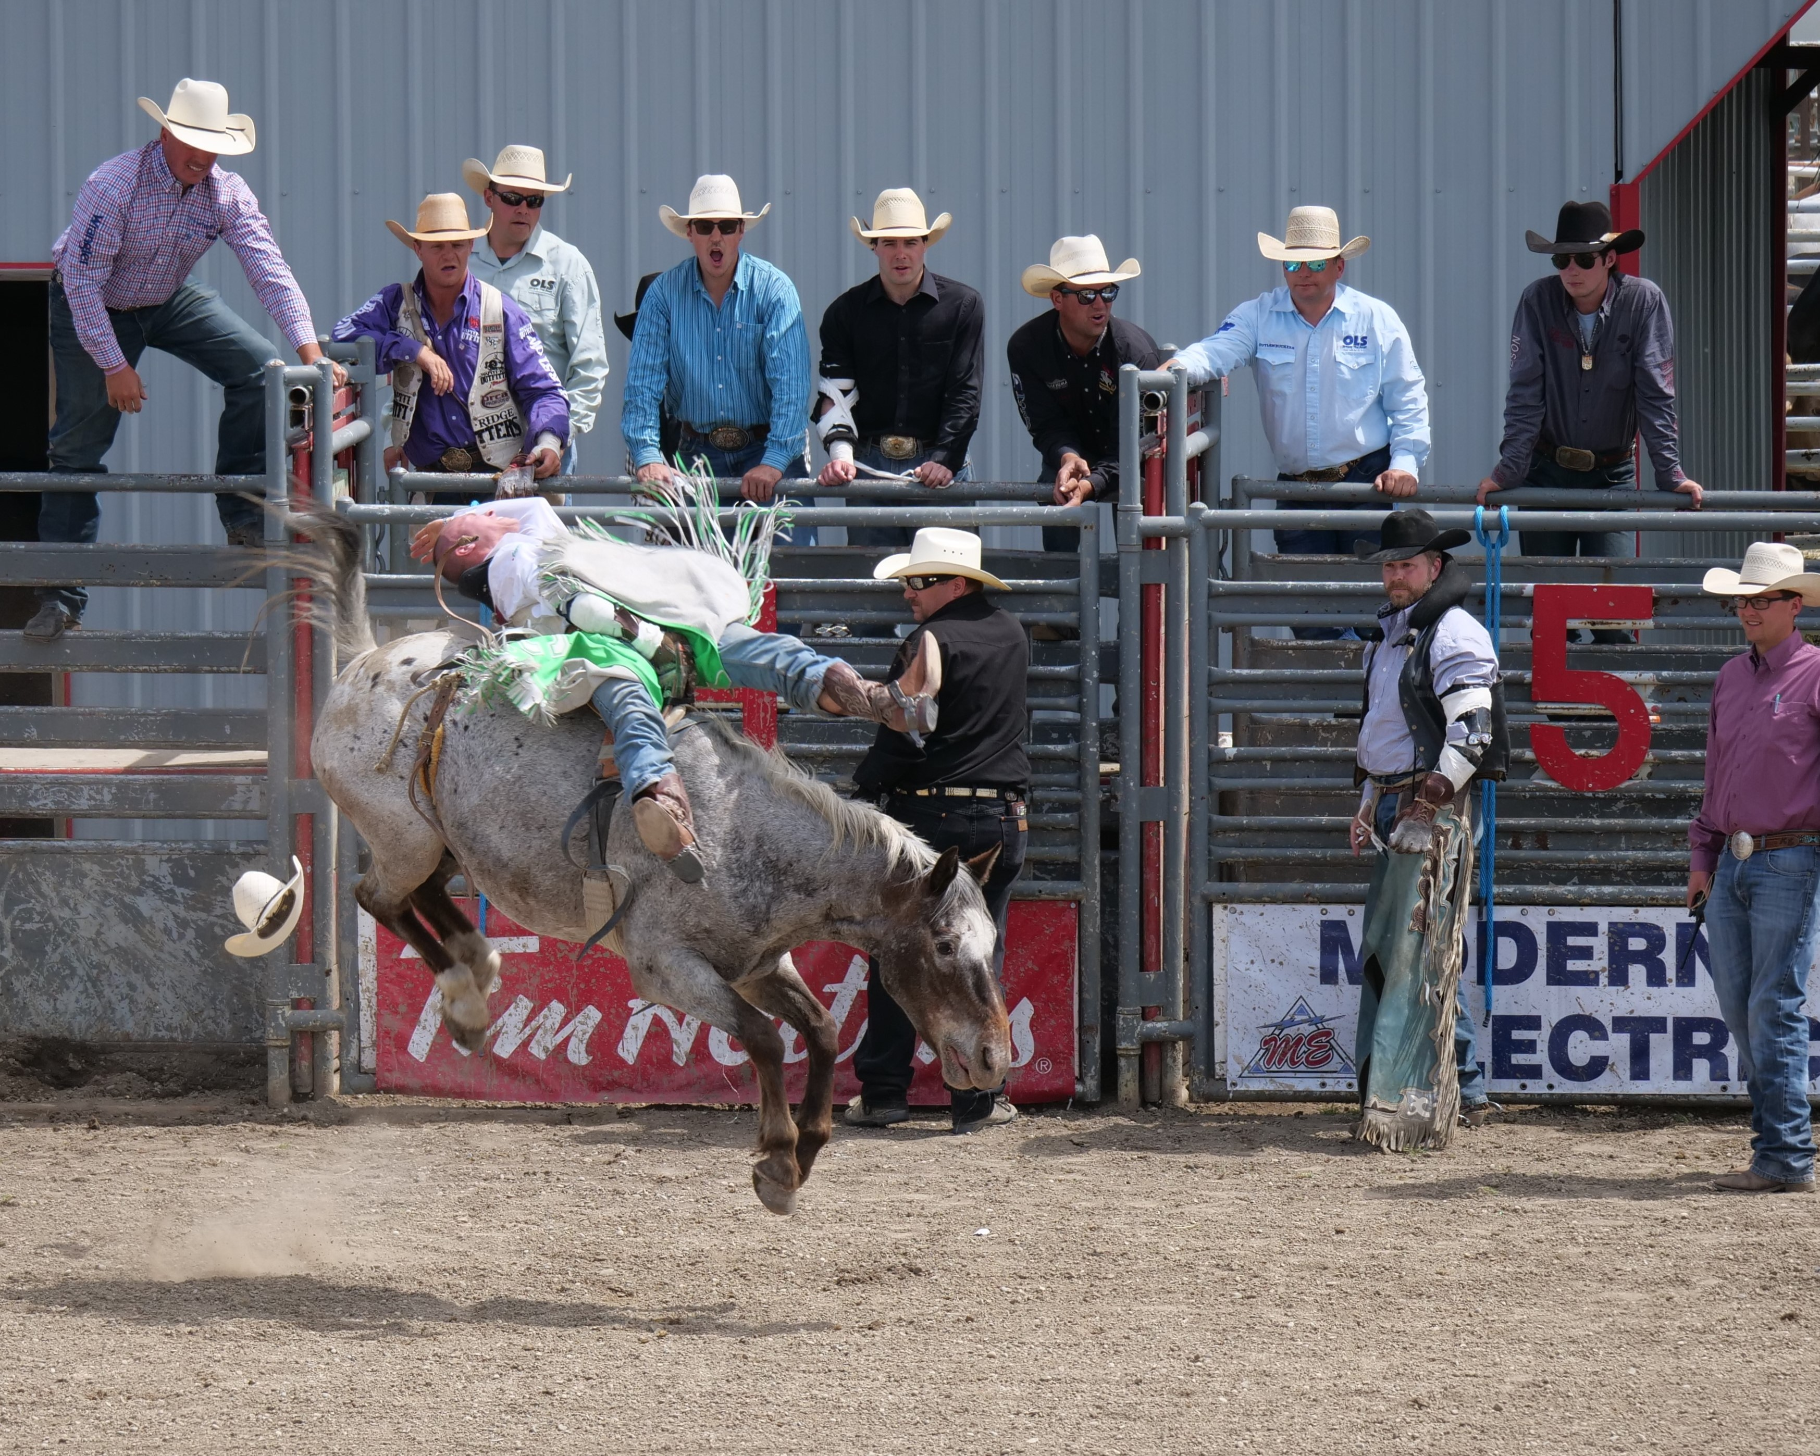
COMMENDED
Bareback Rider
ROGER TWITCHIN

Slide 33
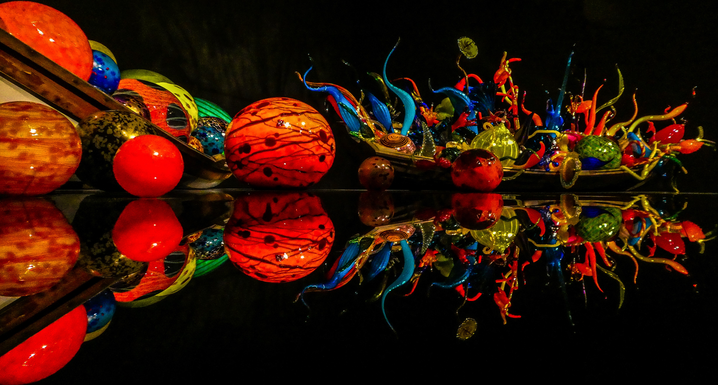
COMMENDED
Chihuly Colour
DOUG GORDON

Slide 34
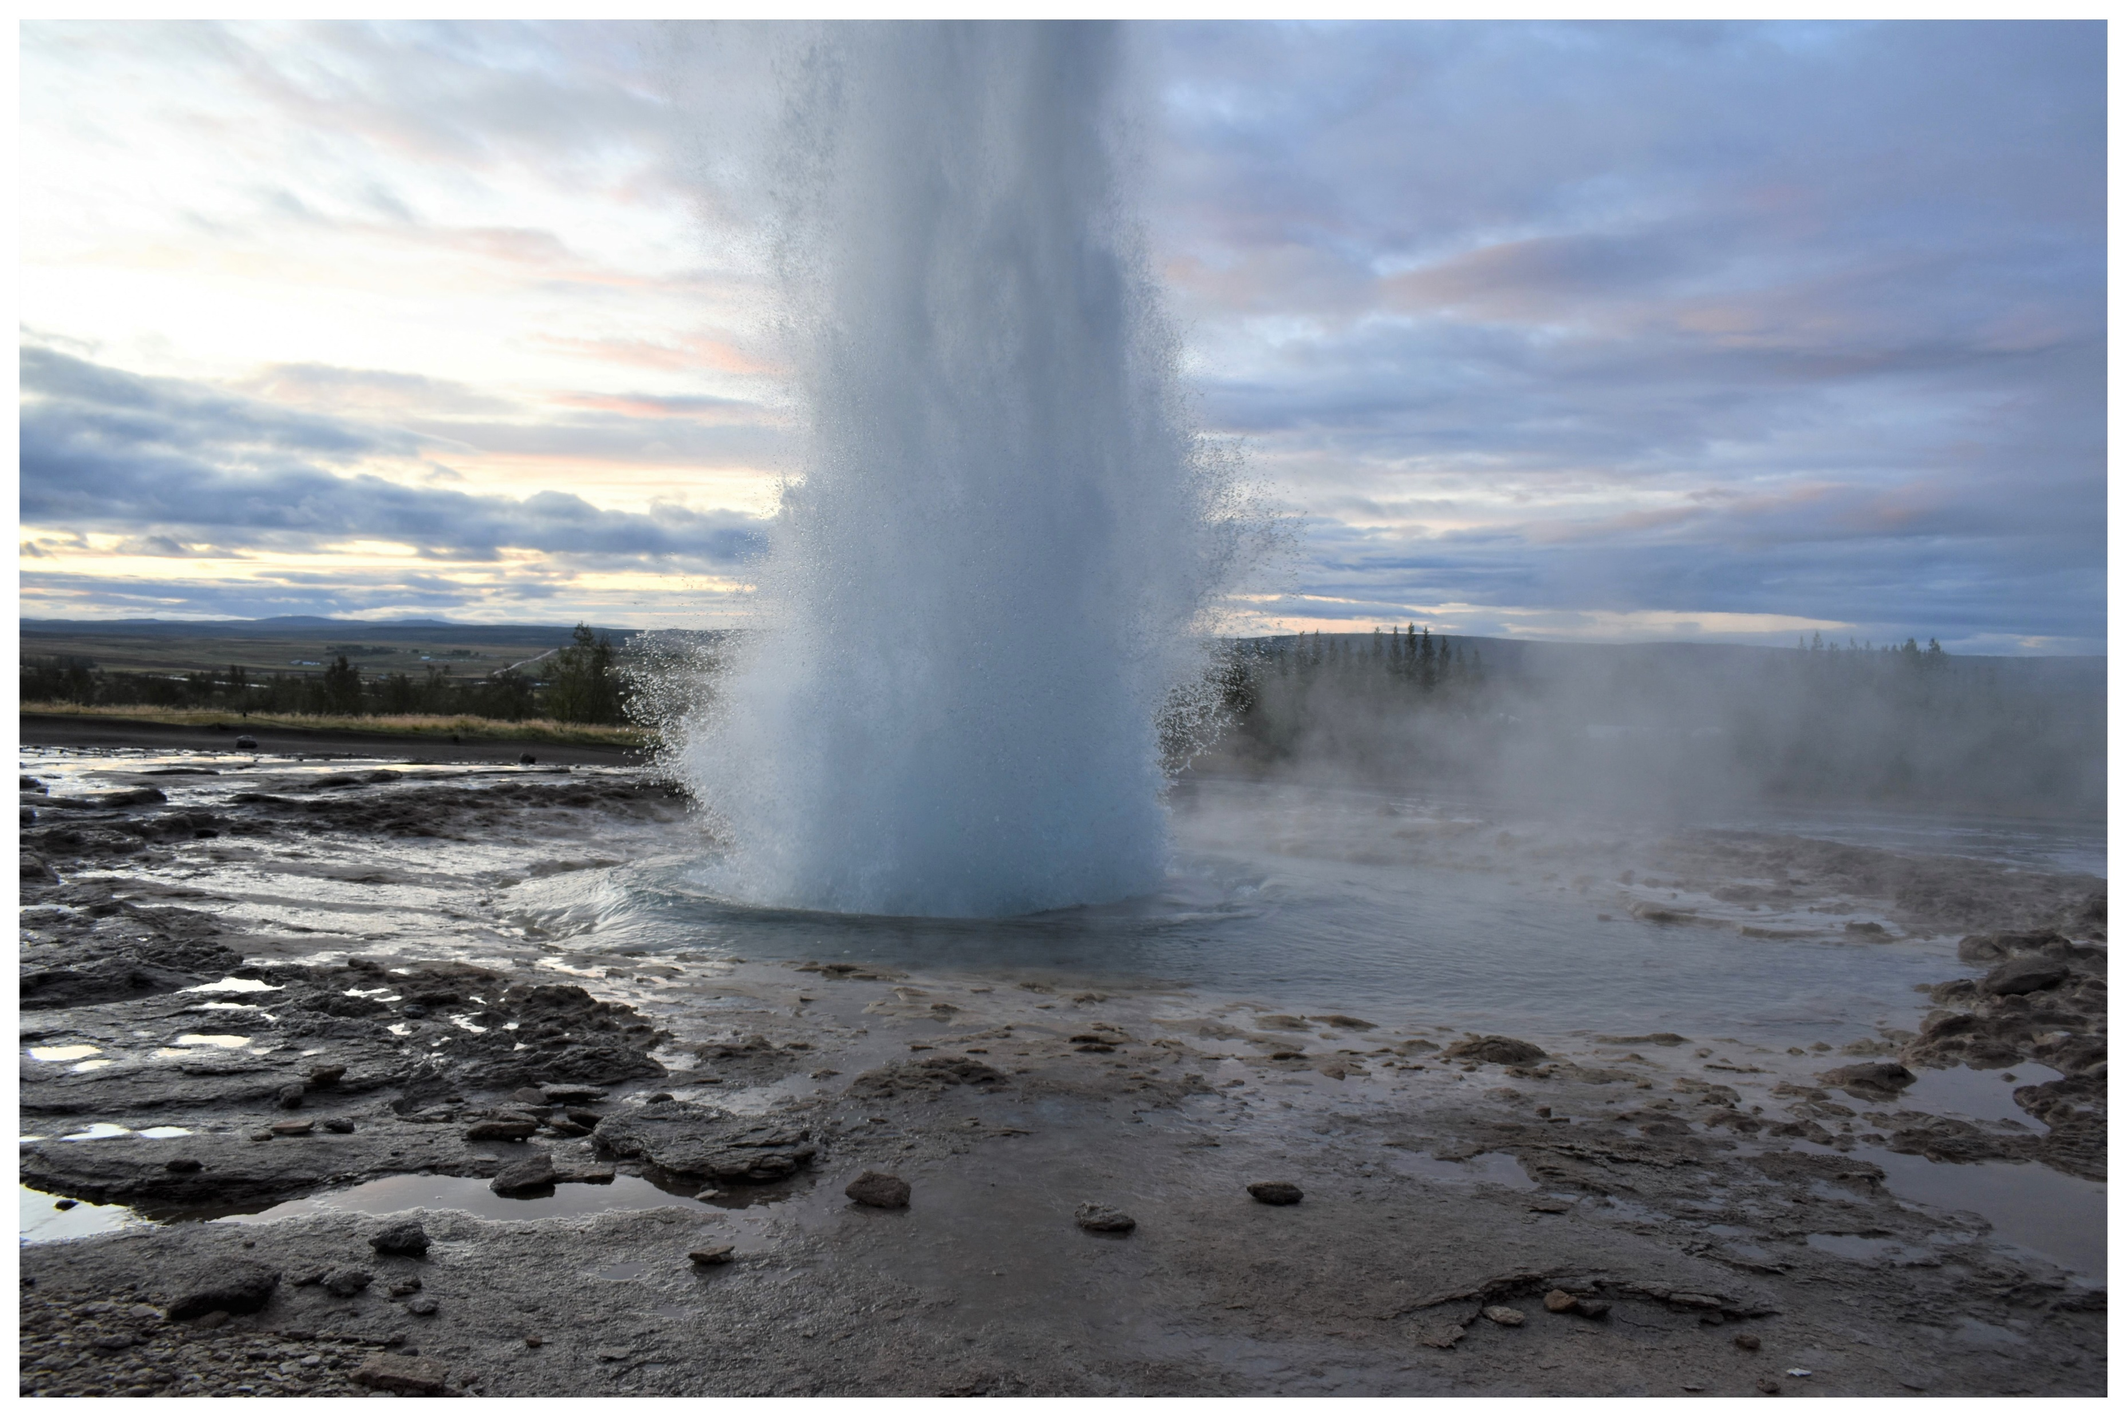
THIRD PLACE
Geyser
MIKE MILLER

Slide 35
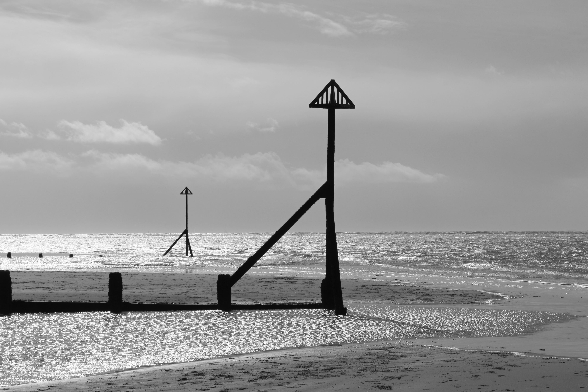
SECOND PLACE
Silver Seas at West Wittering
MADELEINE AYLETT

Slide 36
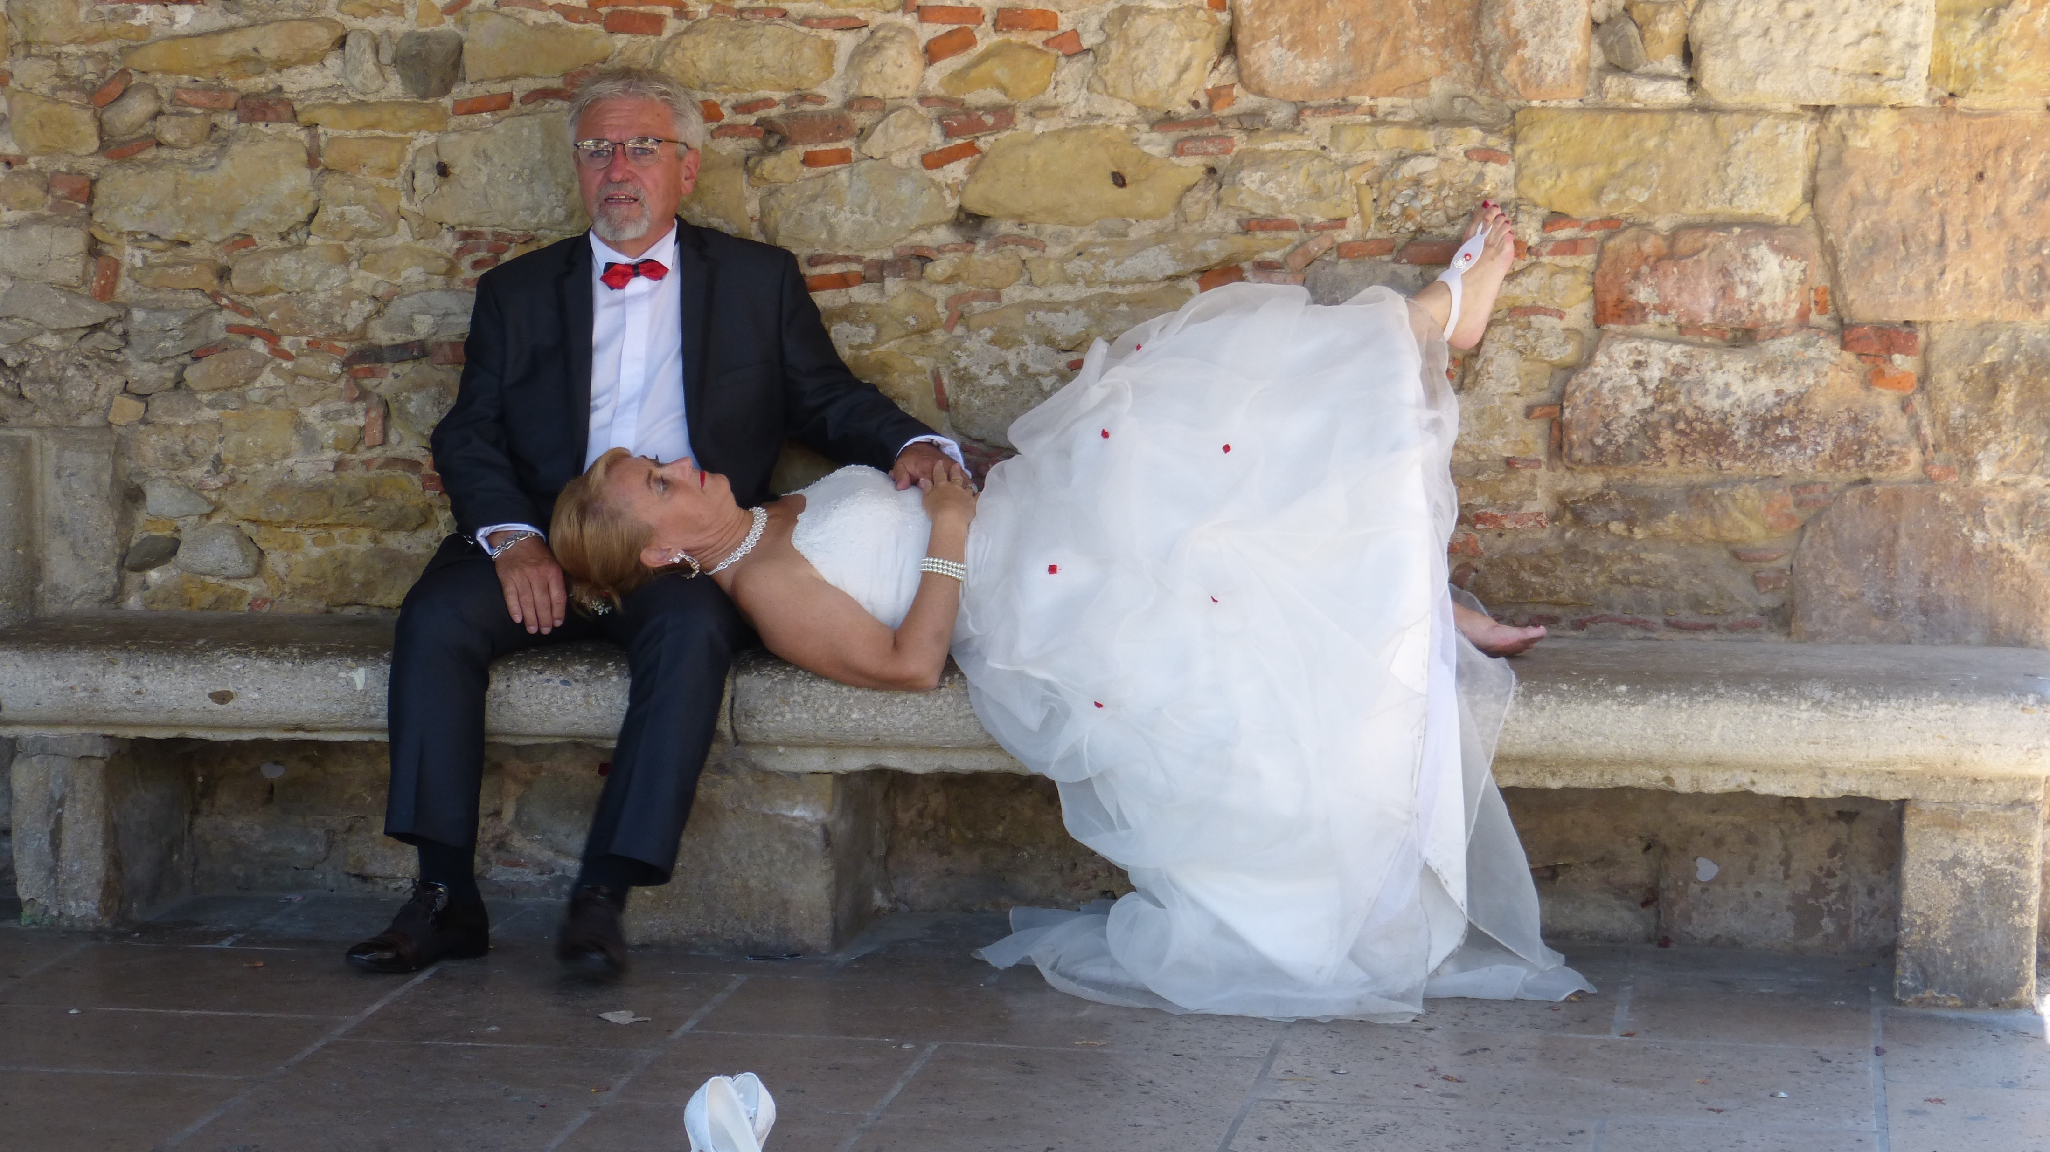
FIRST PLACE
Shoes Off
KAY ROUDAUT

Slide 37
Best Photograph Runner-up, 2020
Salt Pans, Peru – ANDREW SORRELL

Slide 39
Best Photograph, 2020
Are You Sure It’s OK? – SHEELAGH MAYES

