Slide 1
Top Tips: Metering
Tony Watson
(27th April, 2015)

Slide 2
Metering
Correct exposure is function of three interacting parameters (Tony Radnor):
  Lens aperture
  Shutter speed
  ISO
“Exposure Triangle”

Slide 3
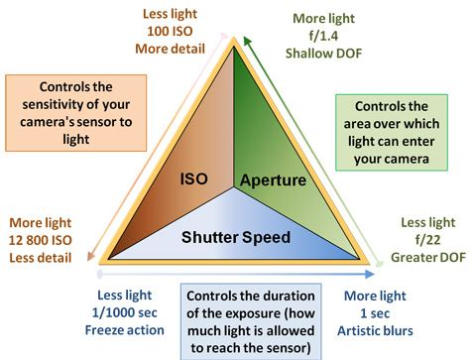
Metering
Exposure Triangle

Slide 4
Metering
“Metering” (measurement of light to expose an image correctly);
In times past you might have used a light meter;
In this digital/automatic age, we tend to take light measurement (metering) for granted;
Today’s cameras have built-in metering system s which automatically measure and average the amount of light entering camera and convert data to appropriate shutter speed, aperture setting and ISO.

Slide 5
Metering
Each camera manufacturer has its own unique light metering system;
Most DSLRs, bridge cameras and high end compact cameras enable photographer to adjust the way a camera measures the exposure of an image and provide a choice of metering modes to suit his/her needs.

Slide 6
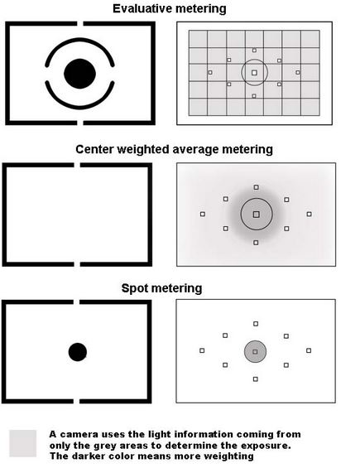
Evaluative (100%)
Centre-weighted (70%)
Spot (approx. 3%)
Partial (approx. 10%)

Slide 7
Metering
Evaluative metering (Canon) or Matrix metering (Nikon):
  Readings taken from all (100%) of the viewfinder area and average taken to calculate the camera settings to expose entire image;
  Tends to be the “default” setting on all cameras and useful for many situations;
  Only metering mode available if camera in any fully automated basic zone mode on mode wheel;
  Can result in “flat” image which lacks contrast but can be adjusted using Photoshop or similar.

Slide 8
Metering
Centre-weighted metering:
  Lighting data taken from approx. 70% of viewfinder area but mostly clustered around the centre;
  Ideal if subject is back-lit, ignores light readings from corners of viewfinder area;
  Really ideal for portraits and for subjects that occupy most of centre of the viewfinder area.

Slide 9
Metering
Spot- or Centre metering:
  Camera takes readings from a very small area (approx. 3%) in centre (focal point) of viewfinder image;
  It evaluates only light readings from a single zone (of 63 zones) or cell and can be very accurate;
  Has advantage of exposing well in generally light conditions by ignoring surrounding light data;
  Ideal for back-lit subjects or subjects that occupy only a small part of the viewfinder (eg, birds or the moon);
  If subject off-centre, use shutter to lock focus and metering, then re-compose.

Slide 10
Metering
Partial metering:
  Somewhere between centre-weighted and spot metering but reads data from a slightly larger centre area (approx. 10%) than spot metering.

Slide 11
Metering - Other Options
Expose for bright subject/area: Expose the darkest area by focusing on that part of the image and part-depress shutter to lock focus and metering; re-compose image and fully depress shutter; darken the brighter areas in post-processing;
Fill-in flash: If subject back-lit, use fill-in flash to brighten front of image;
Reflectors: If subject is top- and/or back-lit, use reflector to throw light back onto front of image.

Slide 12
Exercises
Exercise 1:
Find a subject that is lit brightly from behind and above so that the part of the subject facing the camera is dark (perhaps a flower);
Using Aperture Priority, set the metering mode to Evaluative and take a photograph;
Repeat the exercise using the same subject but change the metering mode to Centre-weighted, Partial (if you have it) and Spot in turn and compare the results.

Slide 13
Exercises
Exercise 2:
Using the same subject as before in the same lighting conditions and using your camera on Aperture Priority, use the camera’s flash to brighten the front of the subject (fill-in flash);
Using the same subject, reflect light upwards and towards the subject using a reflective surface/device. Compare results with the images taken as Exercise 1.

