Slide 1
STITCHING PHOTOGRAPHS
A Brief Guide

Slide 2
Stitching Photographs - Scope
What do we mean by “stitching”?
Why should we stitch photographs together?
What is available to help us?
Conditions and some handy hints.
Demonstrations:
  Canon Ixus 75/Powershot SD750
  Canon’s software package Zoombrowser Ex
  Adobe Photoshop Elements 9

Slide 3
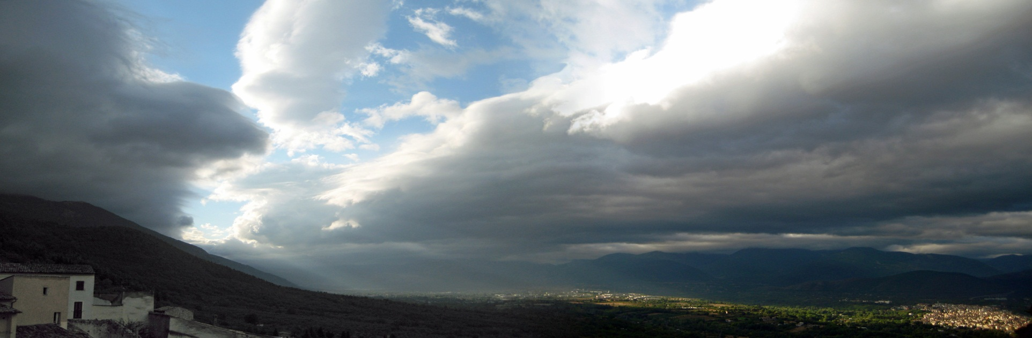
What is “Stitching”?
The process of overlapping and merging two or more photographs to provide a wider or taller image than the camera can achieve in a single photograph

Slide 4
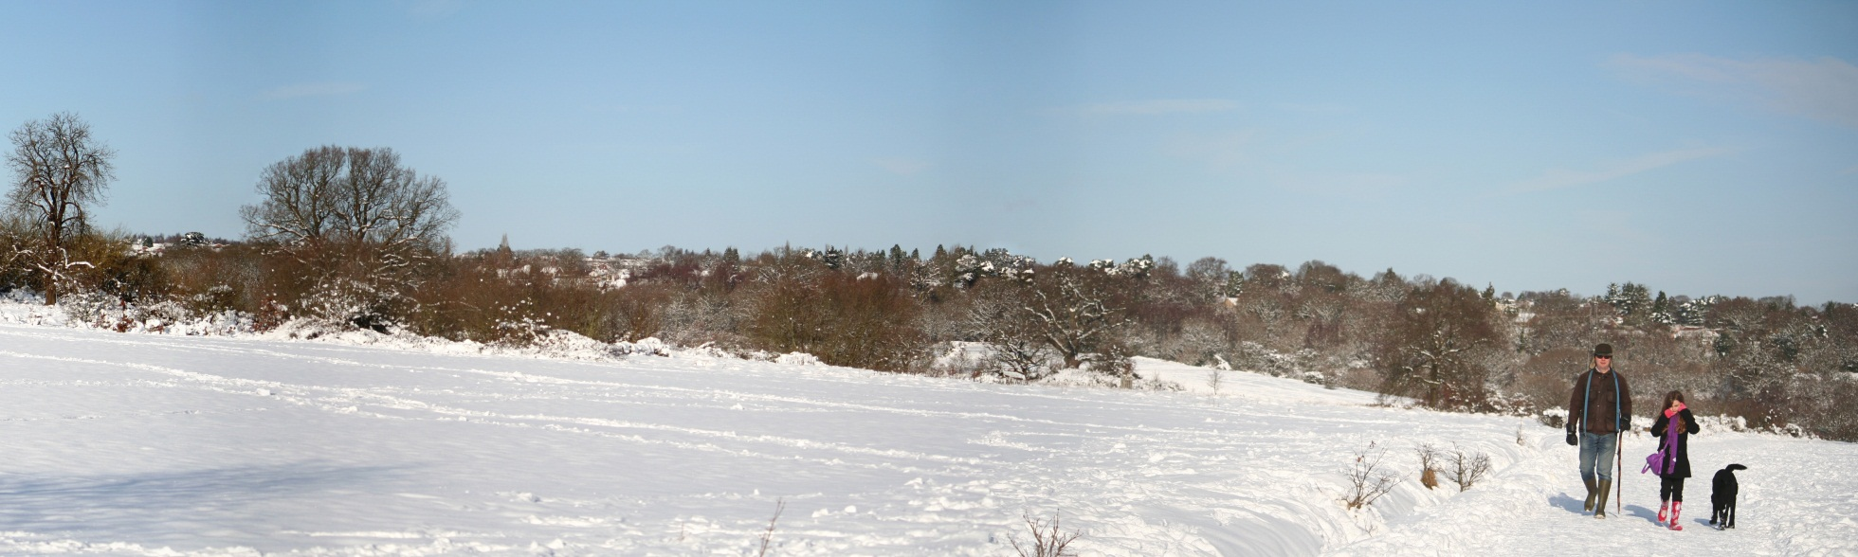
Why Stitch?
To capture magnificent panorama or other feature
Wrong lens!

Slide 5
What is Available to Stitch Photographs?
Camera-based “stitch-assist” facility
Camera software packages
Printer software packages
Commercial/free photo processing packages

Slide 6
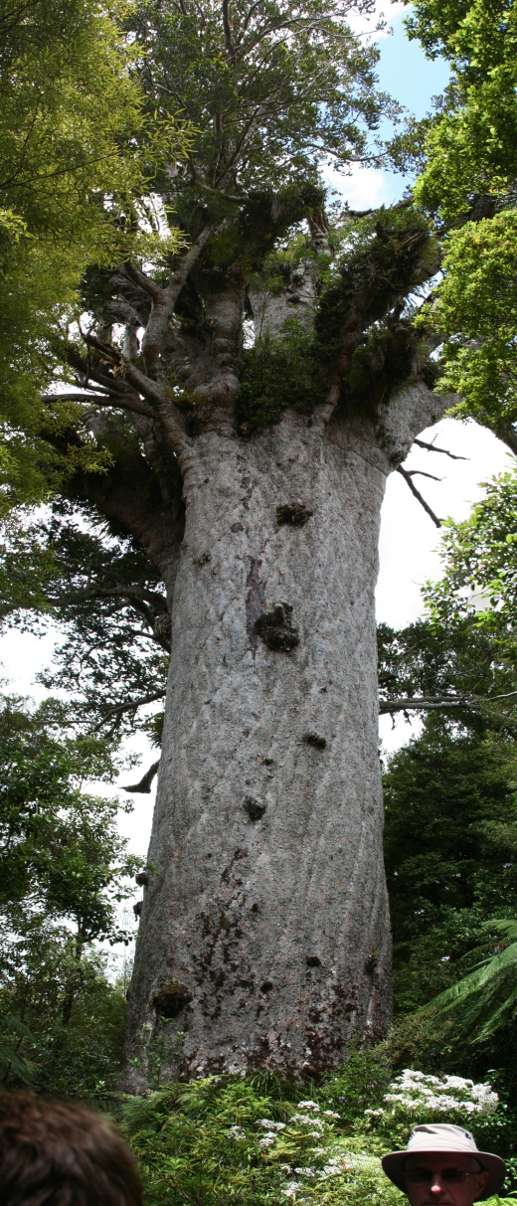
Camera’s Stitch-Assist Facility
Disables the flash
It fixes for the first and subsequent photos:
  Focus
  Focal length (Zoom)
  Exposure
  White balance
  Shutter speed
  ISO

Slide 7
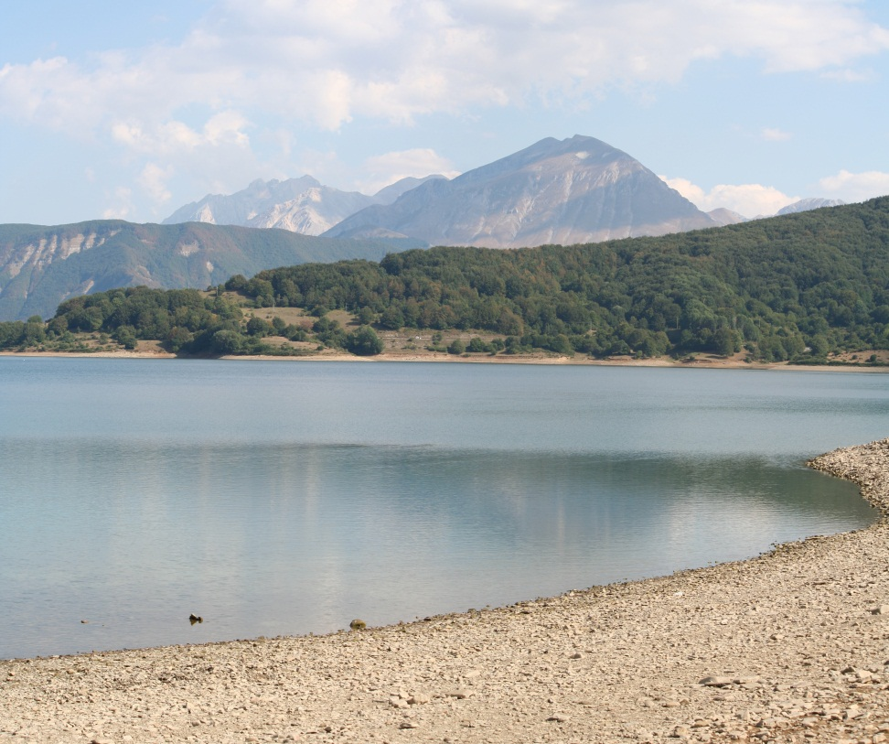
Handy Hints (1)
Ideally, use the camera’s stitch-assist facility
Don’t use distorting lenses
Plan your panoramic photo
Keep camera level and steady; ideally, use a monopod or tripod

Slide 8
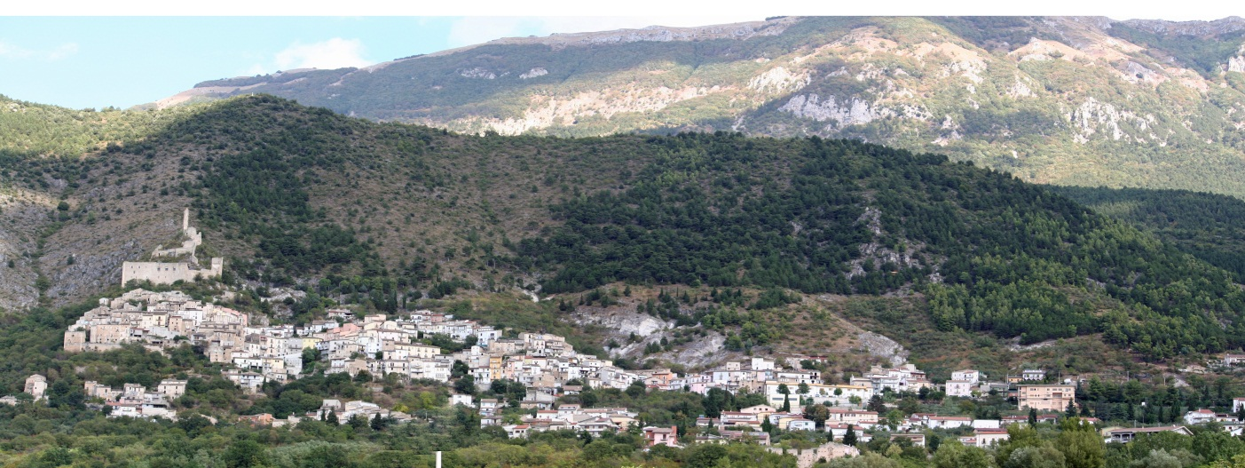
Handy Hints (2)
Use consistent focal length – don’t use zoom midway
Leave sufficient overlap between photographs
Don’t rush ….. but don’t take too long!
Don’t try to join too many photographs
Remember, “rubbish in, rubbish out”!

