Slide 1
Top Tips: ISO
Tony Radnor
(October 2014)

Slide 2
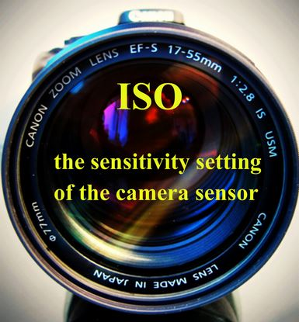
Top Tips: ISO

Slide 3
Top Tips: ISO
“ISO” is the abbreviation for “International Organisational Standard”.
In the past, the sensitivity/speed of a roll of film to light was denoted by an “ASA” number; in the digital age, the “ISO” number relates to the sensitivity to light of the digital sensor (equivalent to film) – the higher the number, the more sensitive/faster the sensor.

Slide 4
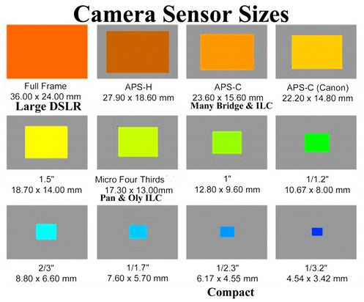
Top Tips: ISO
The chart above illustrates the relative sizes of sensor which are found in modern digital cameras, from large DSLRs to relatively small, compact cameras.

Slide 5
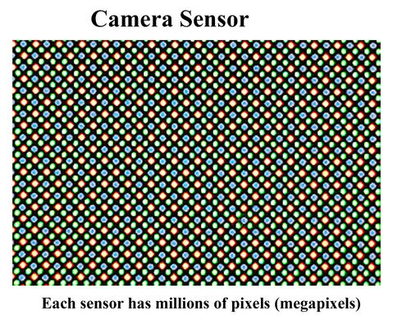
Top Tips: ISO
Each sensor comprises millions of pixels (megapixels), arranged in a pattern of red, green and blue (RGB) pixels .

Slide 6
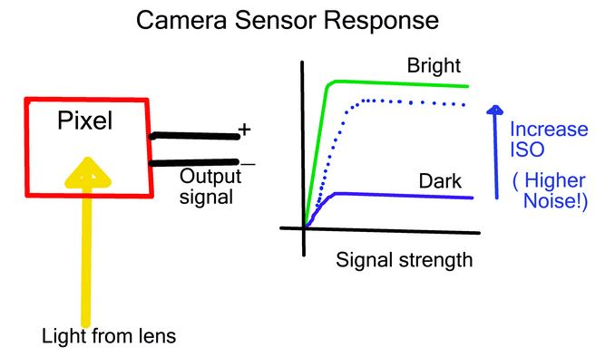
Top Tips: ISO
Light through the lens hits the sensor pixels and these generate an output signal . By increasing the ISO setting you boost the sensitivity of the sensor but the resulting image may show signs of graininess (noise).

Slide 7
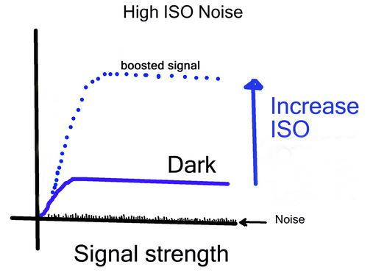
Top Tips: ISO
In very poor light increasing the ISO also increases the effect of the ambient random electrical noise in the ether surrounding the camera. This noise then becomes evident as a deterioration in the image quality. It can be corrected to a certain extent in Photoshop

Slide 8
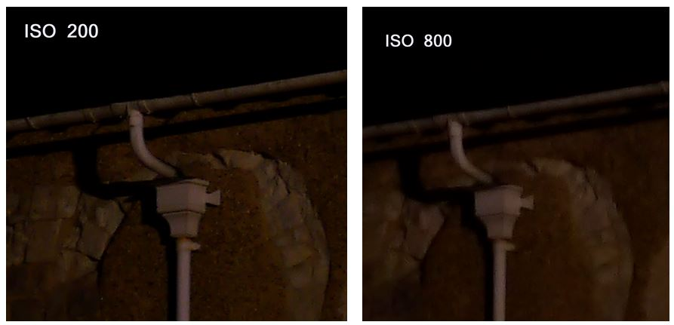
Top Tips: ISO
The above images ( illustrate the effect of increasing the ISO from 200 to 800; note the increased granularity and loss of sharpness in the image on the right.

Slide 9
Top Tips: ISO
Recommendations:
  always use the lowest ISO possible
  in low-lit conditions use a tripod whenever possible
  if no tripod and camera is hand-held use a higher ISO
  generally, use a low ISO with a long exposure; use a higher ISO with a shorter exposure
  in a low-lit large space (eg, a cathedral or cavern, try increasing the ISO setting
  Experiment!

