Slide 1
Top Tips: Introduction
Tony Radnor
(October 2014)

Slide 2
Introduction
Many of us today use our cameras’ auto modes
The “Top Tips” series of talks aims to deliver a series of short, focused presentations on technical aspects of photography.
Wherever practicable, each presentation will include some practical exercises which can be tried in our own time.
The ultimate goal is to wean us all off the fully auto modes by understanding and taking more control of the camera’s settings to control exposure and other outcomes.

Slide 3
Camera Settings for Exposure
There are three principal camera settings that control exposure of an image:
  Shutter speed (usually in fractions of a second)
  Lens aperture size (“f” number; the smaller the f number, the larger the aperture thus admitting more light)
  ISO (sensitivity of the camera sensor)
The following chart illustrates the settings for each of these parameters on a typical digital camera

Slide 4
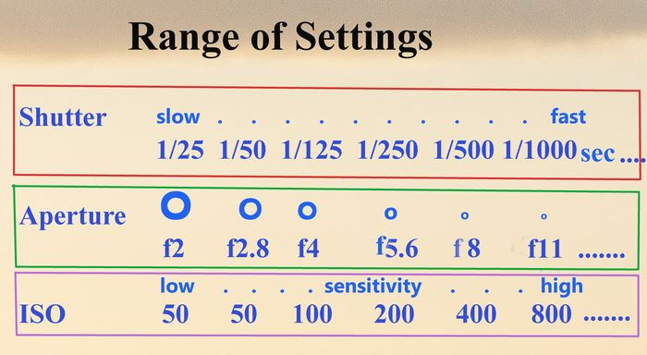
Camera Settings for Exposure
Consult your camera manual or the camera itself to see what range of shutter speed, aperture and ISO settings your camera (and different lenses) support.

Slide 5
Camera Settings for Exposure
It should be noted that, in each case, the settings rise or decrease by approximately half the succeeding or twice the preceding value
Each of these three parameters can be altered by balancing one against another to achieve the same level of exposure
Thus….

Slide 6
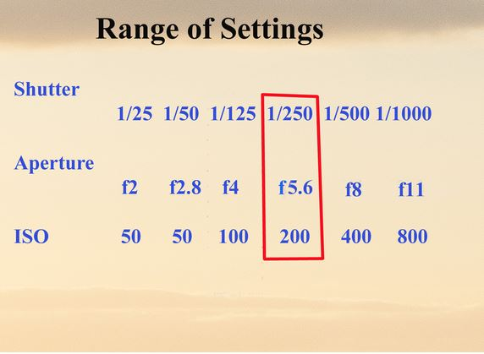
Camera Settings for Exposure
Typical camera settings for a picture on a sunny day; compare these settings with those indicated in the camera’s fully auto mode.

Slide 7
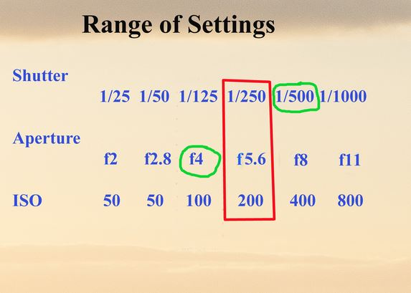
Camera Settings for Exposure
For a sports day perhaps, retain an ISO setting of 200, but try increasing the shutter speed to 1/500 sec (to capture a moving person or object) and balancing this by selecting a lower “f “number (say, f4), which will allow more light into the lens but for a shorter duration.

Slide 8
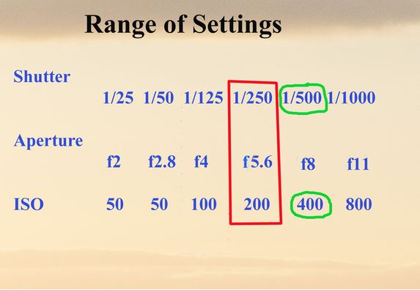
Camera Settings for Exposure
Alternatively, retain the higher shutter speed at 1/500 sec but select an aperture of f5.6 but with a higher ISO figure to compensate for the reduced light capture. Compare the results.

Slide 9
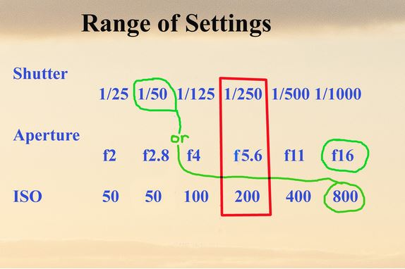
Camera Settings for Exposure
For a landscape image, where depth of field or focus is important, select an aperture of f16 with a shutter speed of 1/50 sec and ISO 200; then try aperture f16 with shutter speed 1/250 and ISO 800. Compare the results.
Experiment!

